Slide 1
Greater Green Bay
Health Care Alliance
Clinical Instructors Annual Update
August 14, 2026

Slide 2
Welcome
Sherri Hanrahan
BSN Program Director | Bellin College &
Chair of the Greater Green Bay Health Care Alliance
August 2026
2

Slide 3

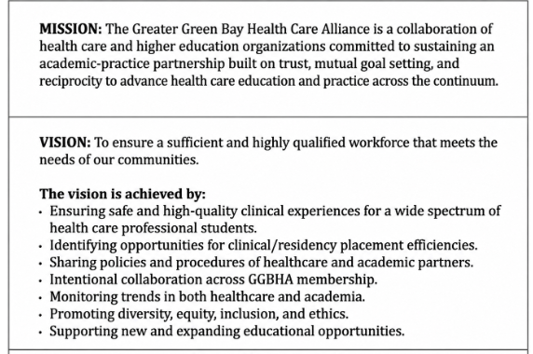
Greater Green Bay Health Care Alliance
GGBHA.ORG
3

Slide 4


Hospital & Clinic
Updates
Advocate Aurora Health
Bellin Health
HSHS Hospitals
Prevea Health Clinics
4

Slide 5
Presenters
Aurora Health Care
Laura Janssen, Professional Development Specialist
Bellin Health
Kelly Verhasselt, Professional Development Coordinator
HSHS Hospitals
Aly Mueller, Clinical Nurse Educator
Prevea Health Clinics
Sarah Schmidt, Talent Acquisition Specialist
5

Slide 6

Aurora BayCare medical center
Laura Janssen MSN, RN, NPD-BC
Nursing Professional Development Specialist
Laura.Janssen@aah.org
(920) 288-3427, Email me for a quicker response
ASC-ClinicalAffiliations@aah.org for EPIC/Workday access questions or other questions
Aurora Locations | Contact
Marinette | Andrea.skolund@aah.org
Two Rivers (Manitowoc) | Jessica.boldt@aah.org
Oshkosh | Christine.Schumann@aah.org
Sheboygan | Kimberly.Wagenknecht@aah.org
6

Slide 7
Leadership updates
Nicole Swanson new CNO for Aurora BayCare Medical Center - July 12th
7

Slide 8
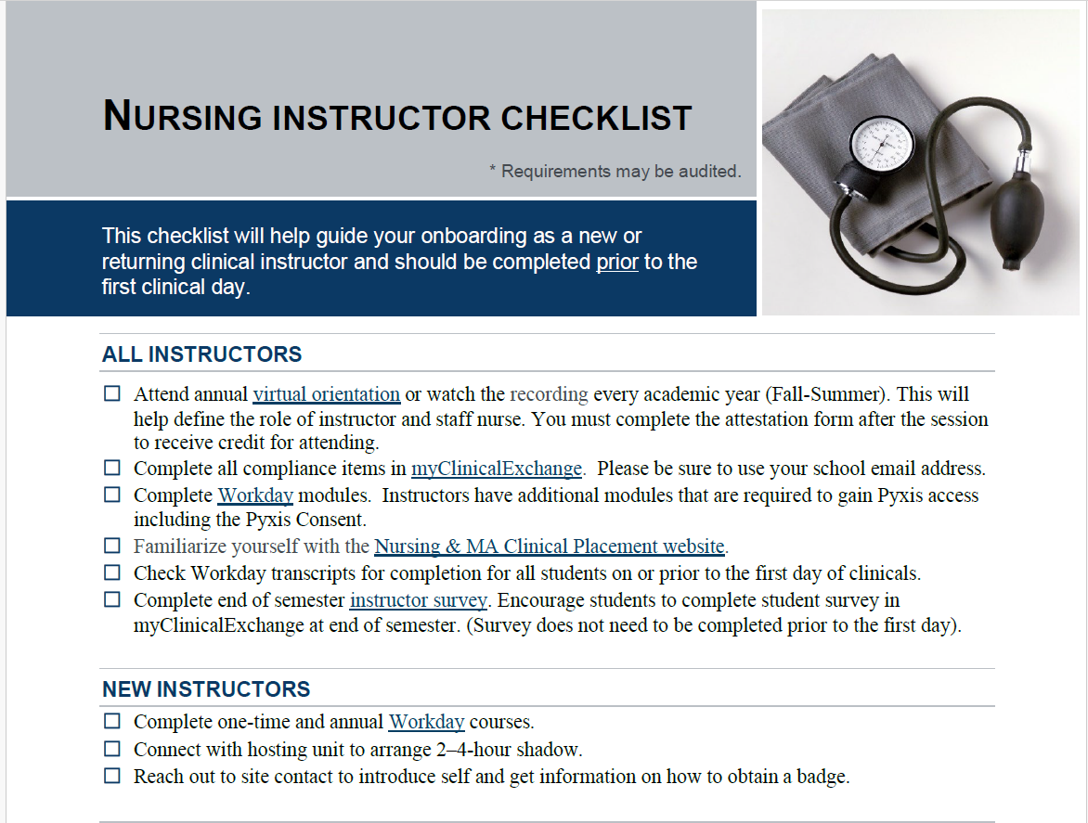
INSTRUCTOR ORIENTATION
All instructors must complete an Advocate Health orientation session once per academic year and attest to their completion (live or virtual session)
Links to register are on the Advocate Aurora's Student's Website: Instructor Orientation
NEW Instructor checklist: Utilize for onboarding documents, process, important needs/deadlines
8

Slide 9
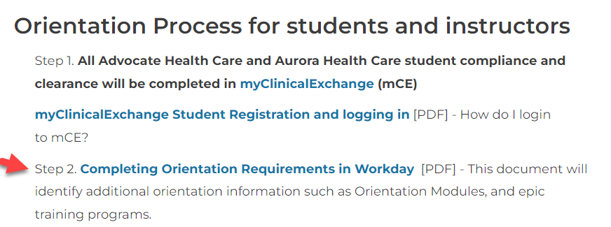
STUDENT WEBSITE
Please review the student website prior to the beginning of every semester.
Nursing & MA Student Clinical Placement | Aurora Health Care
Under Orientation for Students and Instructors section, there is a key document listing orientation requirements.
Annual Education released
For 2026
9

Slide 10
Workday Modules
Any returning students/instructors will have to self enroll into the 2026/2027 Annual Required learning – names of the modules are listed in previous document
NEW instructors and NEW students will be auto enrolled into the modules.
Please check all student’s transcripts for completion – screenshot, etc
10

Slide 11
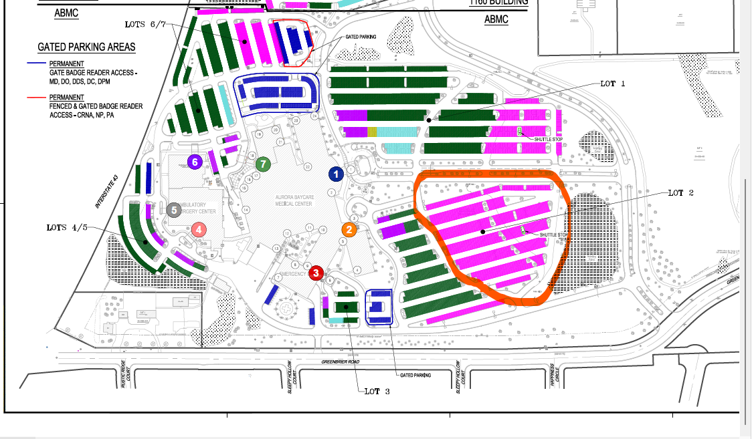
PARKING
Continue to park in the spots beyond the boulevard and enter in Entrance 1.
Entrance 2 is for staff with badge access and remains locked 24/7.
11

Slide 12
Instructor Picture Badges
Aurora BayCare Medical Center (ABMC) will now create an ABMC badge for Instructors. The badge will give you access to hallway doors as well as the medication rooms. Please return any clam (white, blank badges) to security and pick up your ABMC badge.
You will need to submit a picture to security team, or you can take one on site. Please send pictures to Ross.Jasmer@aah.org and cc myself for any follow up
Students continue to wear badge provided by college
12

Slide 13
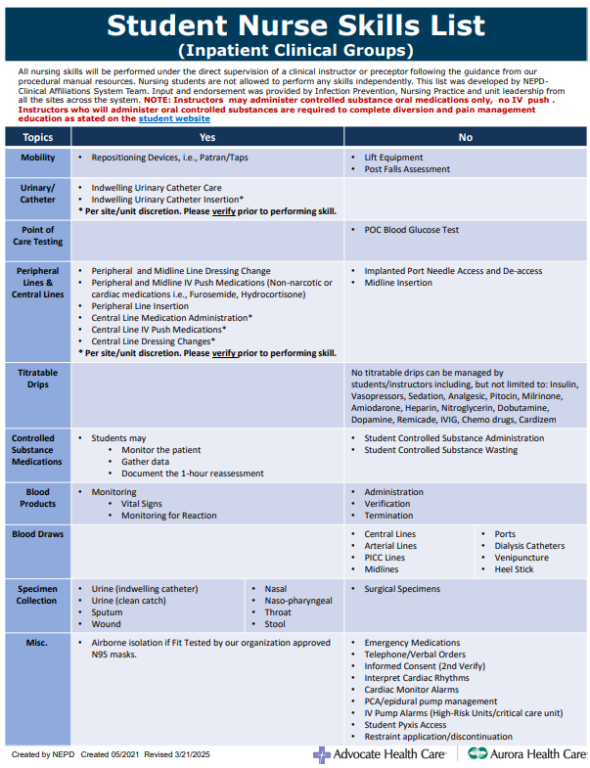
STUDENT NURSE POLICY UPDATES
Please continue to reference the student can and can’t do skills list located on all the units in the tube station room as well as the undergraduate student nurse policy
Aurora BayCare Medical Center skills list and policy may be different than Marinette, Two Rivers, and Oshkosh
13

Slide 14
New Additions to skills list (ABMC specific)
Students and Instructors can insert foley catheters under the following conditions: an ABMC RN must be in the room and depending upon the patient care area, the Urinary Catheter Huddle form must be completed prior to insertion
Students and Instructors can NOT perform central line dressing changes
Students and Instructors can access and administer IV push medications through a central line, check for approved medications.
These skills may vary from Aurora sites – please refer to each site for variances
14

Slide 15

Instructors Passing Oral controlled substances
Reminder that if the instructor would like to remove and pass oral controlled substances – the following workday modules must be completed in Workday:
Reminder that the instructor can only remove the medication and GIVE the oral controlled substance. Please also notify the primary RN for the patient if scheduled or PRN oral controlled substances are being given. This is written in red print on the top of the skills can and can't do list.
15

Slide 16
Cosigning Documentation
Remind students to select their preceptor or instructor as cosigner for EPIC documentation
All documentation must be cosigned by the end of the clinical day – ALL medications administered and any Flow sheet documentation, try to do this in real time
Pull in the "Cosign Report" from the Summary Activity
16

Slide 17
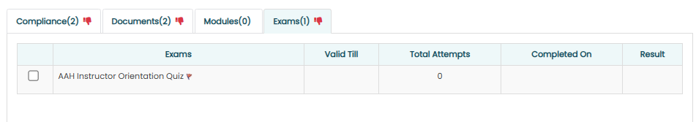
My Clinical Exchange Reminders
Please ensure your students have the green thumbs up for required documents – this will help with delays with obtaining workday and EPIC access
Instructor’s quiz – NEW***
17

Slide 18
MCE Reminders, CON’T
OR and Perianesthesia (Preop and PACU) requests – will now be reviewed by those departments and the department NPDs (Nursing Professional Development Practitioners)
OR 1:1 Precepted led requests – Greg Farr greg.farr@aah.org
Perianesthesia (preop, PACU, same day surgery) – Chelsea Rolain Chelsea.Rolain@aah.org
GI Lab, Cath Lab, and wound will still come to me
18

Slide 19
Practice reminders
Oral care TWICE daily
Sage CHG bath once daily for all patients with central lines and for patients with un-accessed ports
“Wipe the line" with CHG or Prevantics wipes includes wiping all drain, lines, and tubes from the insertion site and six inches down the tubing. One wipe for each line.
Peri care and catheter care once daily, and PRN with each BM
Bed alarms, chair alarms, gait belt when needed, review room signage/whiteboard
Bed alarms for fall risk patients need to be set to Zone 2
No Soap and Water in basins for bath instead use: Sage Bath Wipes, or can use washcloth with running water and soap can be used, new washcloth for each area
New Tube Feeding Pumps – Cardinal Omni
Alaris Pump Interoperability
Call Rapid response for unwitnessed falls
Assign 1-2 students per week to administer medications
Code/Rapid response situations
Telemetry Reminders – will post in chat
19

Slide 20
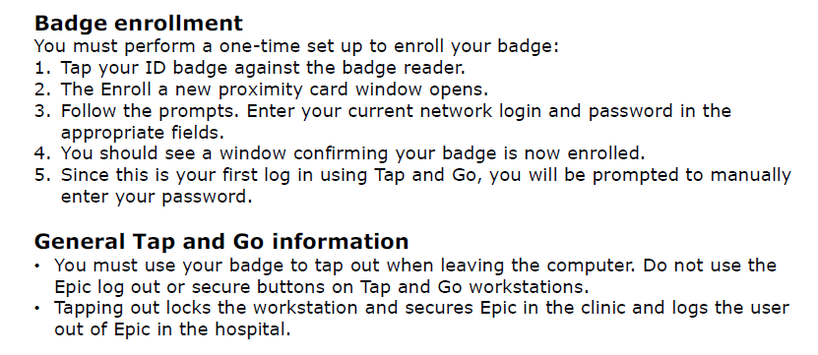
ImprIvata – EPIC Tap & Go – August 11th
^{(Instructors only)}
20

Slide 21
Additional Modules (not required)
“Inpatient Bed Review” – great overview of the Stryker beds, bed alarms, bariatric bed, etc.
"Foundational TIDE (Trauma-Informed De-escalation Education") - Defines Workplace violence and strategies to de-escalate
“Epic IV Pump Integration”
21

Slide 22
Required immunizations
TB test and annual screening questionnaire
Rubella
Influenza (October-March)
Declination form on student's Website for all others – form needs to be uploaded into MCE
Influenza Vaccine accommodation – through "TrackMy" reach out for form/instructions – new code for this year – please email for document/tip sheet
22

Slide 23
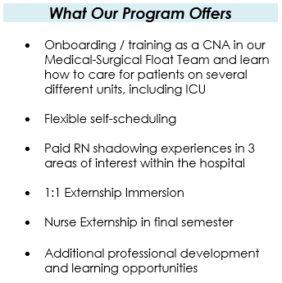
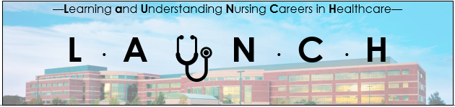
L.A.U.N.C.H. Program
Any nursing student that is CNA certified can reach out to Nichole.lauf@aah.org for more details.
23

Slide 24
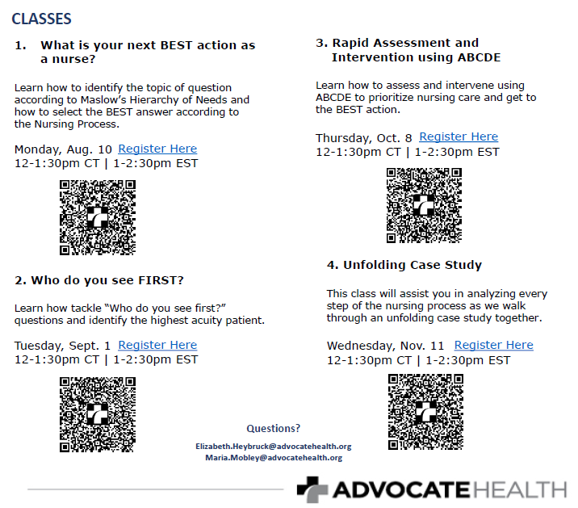
Think Like a Nurse Offerings
Informative Classes for Senior nursing students – will send the flyer in the chat
24

Slide 25
Magnet update
Document submitted in May 2026
September review
Site visit Q1 2027
25

Slide 26

Kelly Verhasselt, MSN, RN
Professional Development Coordinator
kelly.verhasselt@emplifyhealth.org
Carrie Karcz, MSN, RN, AMC-BC
Ambulatory Nurse Educator
carrie.karcz@emplifyhealth.org
26

Slide 27

Emplify Health by Bellin Health
Reminder we are no longer using mCE for student placements
Epic training sessions offered in person and students must complete the training session in order to obtain Epic access
Fit Testing- to be done by school
27
Notes:
Fit testing- The school will be responsible for providing their students with respirator protection in accordance with current regulatory standards, prior to participating in activities that require respirator use.

Slide 28
Organizational Updates
Virtual Nursing Live in 5 Med/Surg Departments (1st/Obs, Cardiac, Medical, Surgical and Ortho) w/ Future expansion to Oconto
  Admissions, Discharges, Transfers, Patient teaching, Mentoring, Charts reviews/Audits, Monitor labs, daily weight, I & O, IV changes, dressing changes, dual medication sign-off
Peds continues to increase the number of surgeries- at SSC
NICU Level III- Family based NICU
Cath Lab: 8 procedure rooms and CT scanner.
  Continued growth in Cath Lab and Cardiac Short Stay may impact ability to accept precepted students
28
Notes:
Virtual nursing is staffed 24 hours a day/7 days a week to support the bedside staff. Ideally one nurse covers one entire department from 07-19, and from 1900-0700 less staff work and assist multiple departments.
We work from a virtual hub that is separate from the hospital (Old ENT building)
Tasks that the virtual nurse can assist with:
Admissions/Transfers/Discharges (this is the majority of the work from 07-19)- completing navigators, required documentation, preparing the AVS and teaching the patient.
Chart reviews/audits- We assist the CAUTI/CLABSI team with monitoring compliance things. Also the virtual nurse monitors labs, I & 0, daily weights, IV changes/dressing changes and also making sure that required documentation is completed.
The virtual nurse can add an interpreter to the call. We can also add a family member to a call so that family can be present virtually to listen if they can't physically be there with the patient.
Peds continues to increase our surgical volumes from Children's (however there is also talk that they are all moving to the SSC
Continued growth in Cath Lab and Cardiac Short Stay have been onboarding a significant number of staff and anticipate another 10 staff yet to be hired. Clinicals for Fall in both CVL and CSSU will likely be an observation of another staff member being trained.

Slide 29
Parking
Parking Lot | Location | Shuttle Hours | Bus Letter
Adams (Lot P) | West of Adams St., under Mason St. Bridge | 0600 - 2100 | A
Jefferson (Lot Q) | East of Jefferson St., under Mason St. Bridge | 0600 - 2100 | A
Roosevelt (Lot O) | Corner of East Mason and Irwin Ave. (Site of former Roosevelt School) | 0400 - 0030 | R
1200 East Mason (Lot M) | Corner of East Mason and Roosevelt St. | No Shuttle
Mason St. Walk (Lot J) | On East Mason between Clay St and Roosevelt St. | No Shuttle
Martin Hardware (Lot R) | On East Mason St. between Roosevelt St. and Irwin Ave. | 0700 - 0030
617 Roosevelt (Reserved for Bellin Homecare Equipment staff) | Across Roosevelt St. from the Mason St. walk lot. | Reserved Parking only. No Shuttle
Kasten Madsen (Lot T) | Mason St. | No Shuttle
29
Notes:
Shuttle Bus Operation:
Shuttles operate on 10-15 minute time intervals
Shuttles operate Monday - Friday. Shuttles do not operate on weekends or major holidays.

Slide 30
Ambulatory Updates
Construction occurring in our Bellevue Clinic location, which may interrupt student placement in that location (Bellevue Family Practice and Bellevue Urgent Care)
Some clinics changing to Rural Health designation. This may lead to some changes to their workflows
Technology:
  New measuring boards in ambulatory clinics treating peds patients
30

Slide 31

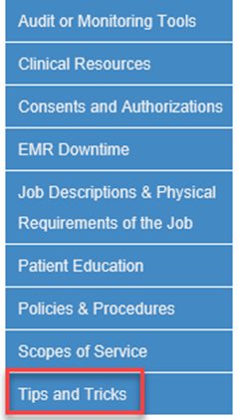
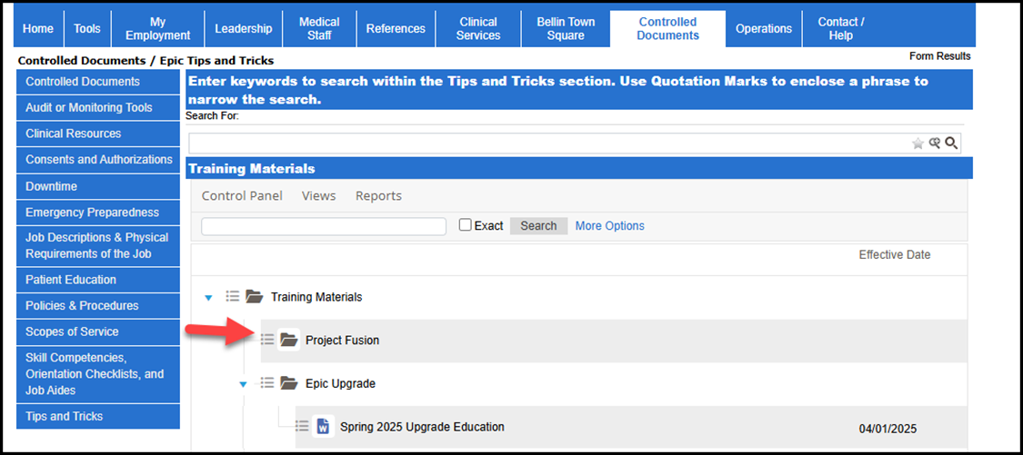
Epic
Finding Upgrade Documents on Julius Find and reference upgrade education any time by visiting the Controlled Documents page of Julius.
Open Julius.
Select the Controlled Documents tab.
Select Tips and Tricks on the left side
Project Fusion Learning Pathway
31
Notes:
Access to guides or short videos via the Learning Pathway site.

Slide 32
Co-signing Student Documentation
Faculty can run reports to verify all student charting has been reviewed and co-signed.
Select the appropriate reports and click run:
BLN IP LPN/SNT/GN Missing “My” Cosign for Flowsheets and BLN BPC LPN/SNT/GN
Missing My Cosign for Flowsheets will look for any of your patients in the department you are currently logged into needing flowsheets cosigned.
32
Notes:
Reminder for faculty to review and cosign student charting.
By picking the one with “my” in it they will get the ones assigned to them. If they pick the other one they will get all the patients for the floor in the last 30 days.

Slide 33
Infection Prevention: Vaccines
Vaccine | Policy | Evidence of Compliance | Declination/Exemption Allowed:
COVID-19 | Optional | Written documentation of vaccination | Yes- complete vaccination refusal form
Influenza | Optional | Written documentation of vaccination | Yes- complete vaccination refusal form
Hepatitis B | Optional | Written documentation of vaccination | Yes- complete vaccination refusal form
Measles Mumps | Required | Written documentation of 2 doses of vaccine, or laboratory confirmed immunity. | No
Rubella | Required | Written documentation of 1 dose of vaccine, or laboratory confirmed immunity. | No
Varicella | Required | Written documentation of 2 doses of vaccine, or laboratory confirmed immunity. | No
33
Notes:
The deadline for declination request for influenza is due by November 1st annually. Unvaccinated will not need to mask, instead masking will be based on this guideline: In the case of increased local, regional, or state spread of respiratory illnesses, masking and/or other source control measures needed to prevent the spread of illness may be required regardless of one's vaccination status and at the discretion of Infection Prevention.

Slide 34
Policy Updates / Changes / Reminders
  Bladder scanning & Urinary management Policy-
    New Foley Removal Protocol and Bladder Scanning Tool
  Hypoglycemia Policy
    New treatment guidelines for Type 1 & Type 2 Diabetes
    Treating blood glucose <54 mg/dl with 30 grams carbohydrate glucose tabs (found in Pyxis)
    Document all glycemic symptoms and treatments in the Epic “Glucose Management” flowsheet when live
  Blood Culture Policy
    Revisions for both adult and pediatric patients
  Standard & Transmission-Based Precautions Policy
    "Protective Precautions" rather than neutropenic precautions
  Transporting Patients Interdepartmentally
    Revisions on which patients must be transported with an RN
34
Notes:
Bladder Scanning and Urinary management: changes on straight cath protocol.
Hypoglycemic Policy: Previously blood sugars <50 mg/dl were treated with 30 grams carbohydrate
Per Diabetes Care 2026, “Level 2 hypoglycemia (defined as a blood glucose concentration <54 mg/dl is the threshold at which neuroglycopenic symptoms begin to occur and requires immediate action to resolve the hypoglycemic event.”
Blood Cultures: changes to prep and cleaning and updates on blood volume (for those who are a difficult stick or not enough blood). Laminated sheets on the units outlining collection steps
Protective Precautions is now used rather than neutropenic precautions. Protective Precautions are ordered at the discretion of the attending provider, or requested by a patient, for patients who are immunocompromised and/or at patient’s personal preference for their HCWs to mask while providing them care.
Transporting Patients: Revisions on which patients must be transported with an RN

Slide 35
Policy Updates / Changes / Reminders
Code Status Orders
  Full Code: Full resuscitative measures
  DNR: Intubation but no compressions.
  DNR/DNI: No compressions, no intubation.
  DNR/Comfort: Let natural death occur.
35

Slide 36
Equipment Updates / Changes / Reminders
Bluetooth chair alarms some rooms- Do not turn off the wall mounted alarm device ‘on off switch on back’ , ok to press the button on top to pause the alarm.
Do not turn off bed alarms, instead, pause the alarm with the ‘yellow bell’ pause option on all beds.
36

Slide 37


Practice Reminders
Document care provided, I & O, Oral Care BID + PRN,
Those students MUST let the primary nurse know they will be passing meds and keep open communication about cares given or change in condition
Make sure IV tubing is labeled
Ideally students should be present for shift report
Please communicate with CNAs as what cares will be provided
Avoid group gather-rounds
ThePhoto by PhotoAuthor is licensed under CCYYSA.
37

Slide 38
Practice Reminders
For those going to BPC
For instructor-led clinical groups, the goal of this rotation is observation rather than provide direct patient care.
  For preceptor-led clinical groups, the focus of this rotation is on nursing soft skills (therapeutic communication, active listening, rapport building, motivational interviewing, boundary setting).
  Preceptor led students will document assessments and progress notes.
  For safety, please do not wear scarves, ties, dangling earrings, or hoods. Students are instructed to not participate in any physical, hands-on intervention with patients.
38
Notes:
Group led- chance to observe unit flow and learn what inpatient mental health treatment involves. If possible, you may also observe group sessions and the intake process.

Slide 39
Nurse Intern Opportunities
The nurse intern (formerly Student Nurse Tech) program is intended to provide nursing students with the opportunity to develop skills that will benefit them in their professional growth and development. Working as a nurse intern can provide students with a great foundation for nursing.
ADN: Eligible at the start of your final semester
BSN: 3 year: eligible at the start of final semester
  4 year: eligible when starting senior year
    15 month: eligible during the final 7 months of your program
    visit careers page: www.bellin.org/careers
39

Slide 40
Emplify Staffing Changes / Updates
Educators
  Nicole Bebo Oconto Campus
  Janet De Voe Surgery
  Jennifer Hazaert Surgery
  Shannon Kazik Cath Lab, 5th Short Stay
  Brock Maroszek Peri-op
40

Slide 41

HSHS Hospitals
St. Vincent, St. Mary’s, St. Nicholas, St. Clare
Aly Mueller, MSN, RN, RNC-OB ,C-EFM
Clinical Nurse Educator
41

Slide 42
Executive Leadership Changes
St. Mary’s
Chief Administrative Officer-Leah Bergstrom
St. Vincent
Chief Nursing Executive-Jennifer Morton
St. Nicholas
Chief Administrative Officer-Andrew Bowman
St. Clare
Chief Administrative Officer-Colleen Koski
42

Slide 43
Leadership Changes
St. Mary’s
Emergency Department-Mel Jacobson
St. Vincent
Emergency Department-Carson Kraft
NICU-Sara Johnson
Women & Infants-Tanya Schuettpelz
CVICU/Intermediate Care Unit-Jennifer Bosetski
Critical Care Services-Kristy Fane
St. Nicholas
St. Clare
43

Slide 44
General updates
Covid proof of Immunization
No longer required for HSHS
HSHS Rehab Hospital
Now open, separate contracts required if seeking placement
St. Vincent Rehab Unit-tentative close date of 8/31/26
44
Notes:
Reach out to Jenn if you need the Rehab contract contact

Slide 45
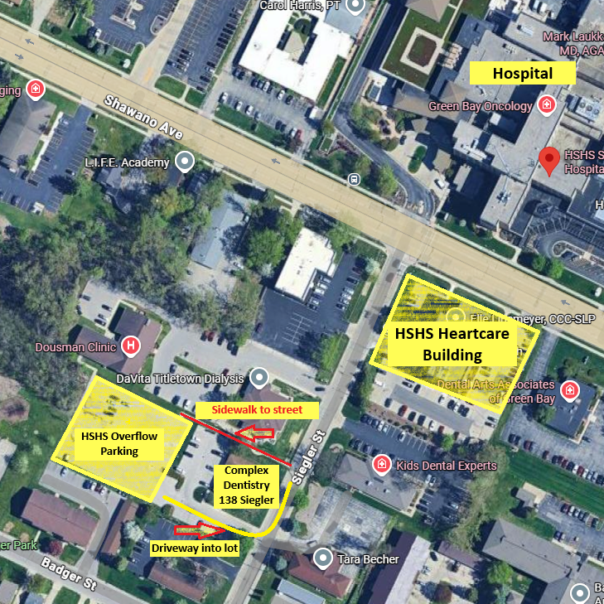
Reminders
Parking
St. Mary’s
  Day shift: park in HSHS overflow parking
  PM/Night shift precepted: Park in Employee parking in main lot
St. Vincent:
  Day shift: Continue to park in overflow lot
  PM/Night shift Precepted: may park in ramp
Co-signing of Documentation
Please continue to ensure cosigning completed prior to leaving clinical day
45
Notes:
No changes

Slide 46
HSHS Group Instructor badge process
Placement approved through usual process (managed by Clinical Education)
Upon acceptance notice, Clinical Coordinator completes form and submits Epic/Pyxis access request form to identity email address AND HSHS Access Coordinator
Badge will be created for new group instructors (will have name and ‘Instructor’ on badge)
Access is granted from Onsite Start Date to Onsite End Date for designated units. Badges are available before Day One at the Security office of the respective clinical site.
Upon Onsite End Date, clinical instructor do return badge to Security Desk. Pick up again at start of next clinical rotation.
  Subsequent clinical rotations: Instructors will not have a badge created for each clinical site. If the instructor changes location, instructor to pick up badge at site where it was previously turned in.
46

Slide 47
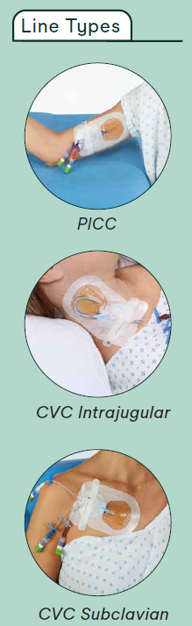
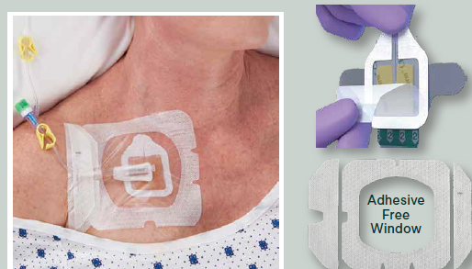
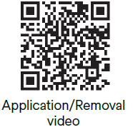
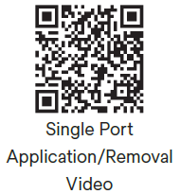
Products
Solventum Dressing Changes
CHG impregnated dressing
Central line and port
47

Slide 48
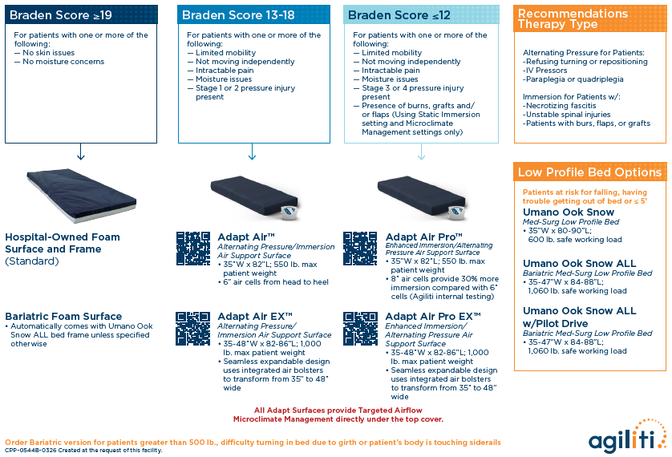
48
Notes:
Foley Free ICU meant to remove foleys used for HOUDINI criteria of strict I&O
No clinical groups on ICU, but for precepted students, good for awareness
Wireless chair and toilet alarms-check with unit leaders or charge RN for information about how to use. Disposal requires lithium batteries to be taken off of toilets or chair pads

Slide 49
Initiatives
Hester Davis Falls
Update to falls risk assessment
Interventions based on scoring
  Updated signage
  Falls mats (coming soon)
Scoring tools for:
  Inpatient
  Emergency Department
  Maternal
  Peri-Op
Hester Davis Pressure Injury Prevention-coming soon!
49
Notes:
Training to begin mid-September and run through week of Thanksgiving. Go live date of 12/2.
If interested in training, email jenn.leonard@hshs.org

Slide 50
Initiatives (cont.)
Foley Free Hospital Wide
Go-live date TBD
Watch for updates on units prior to go-live
50
Notes:
Training consists of online learning module, classroom portion (3.5 hours), practice packet completion (optional), and test.
Empowers RNs to know what’s going on with their patients (cardiac wise) when they get a call from Telemetry Technician.
Remote monitoring continues as previously, but eliminates RN not knowing what a rhythm change means.

Slide 51
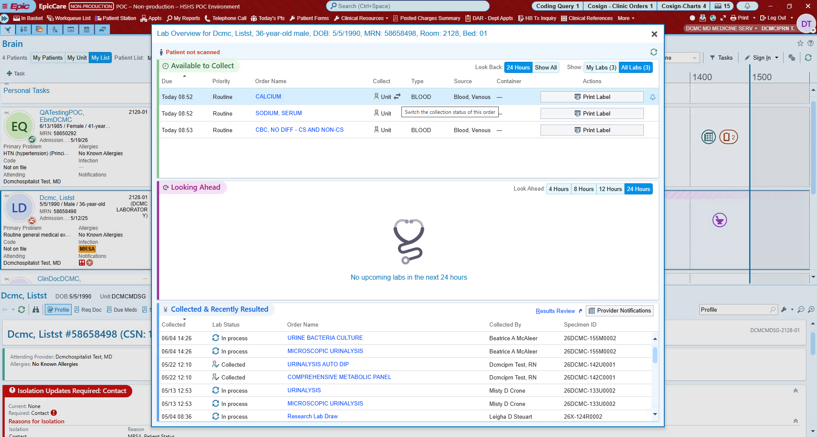
Epic Beaker
Transition to Epic lab platform
Go live date 8/1/26
Will require scanning of patient armband
Tipsheets on Lab Learning Dashboard in Epic
51

Slide 52
Expectations during a medical emergency
If in patient room when medical emergency begins, remain in room to provide information and assist with care as requested (i.e., BLS).
If assigned to patient experiencing medical emergency but not in room, respond, and wait to determine if space allows entrance.
If not assigned to patient experiencing medical emergency, assist within rest of the department. Please do not respond to room experiencing medical emergency.
52

Slide 53

Student Opportunities
HSHS Scholars program
  Scholarship funding (up to $10,000) for commitment to work at HSHS following nurse licensure
Summer nurse intern program
  Four-week experience for students who have completed at least 1 MedSurg clinical
  Shadowing experience (2 weeks MedSurg, 2 weeks specialty)
  Practice assessments, see day to day life of an RN
  Goal to retain interns into Nurse Extern 1 positions
53

Slide 54

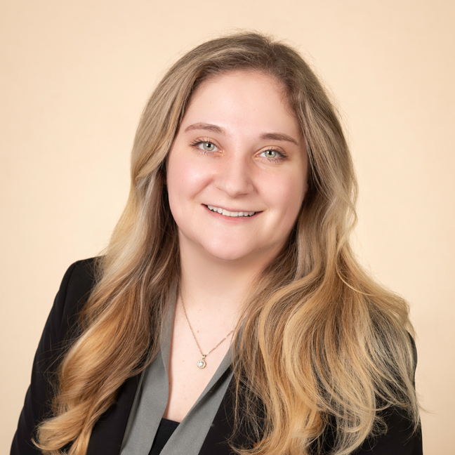
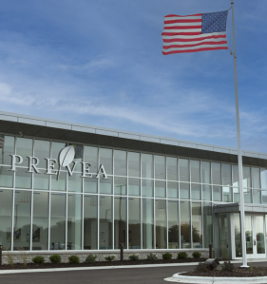
Prevea Health Clinics
Sarah Schmidt
Talent Acquisition Specialist
Sarah.Schmidt@prevea.com
920-429-1779
Nicole Mroczynski
Clinical Educator
Robin Nau
Clinical Educator – NEW!
54

Slide 55

Types of Rotations
Medical Residents
Medical Students
PA and NP
Therapy, including PT(A)/OT(A)
Medical Assistant
LPN
Surgical Technician – at ASC
Medical Laboratory
Healthcare Business
BSN Transitions
Radiography
Mammography
Ultrasound OB/GYN
Ophthalmology
Neurotechnology
55

Slide 56
Requests / Onboarding
For NP, PA, non-MCW Medical Student, Social Work, Dietetics, and Therapy rotations, use www.myclinicalexchange.com to submit rotation requests and complete compliance items.
  Forms have been updated (Application and Attestation)
  Only fee for this is the mCE fee ($39.50/annually) isn’t associated with Prevea
All other programs use the traditional GGBHA process.
  Phone number required for Epic Access
56

Slide 57
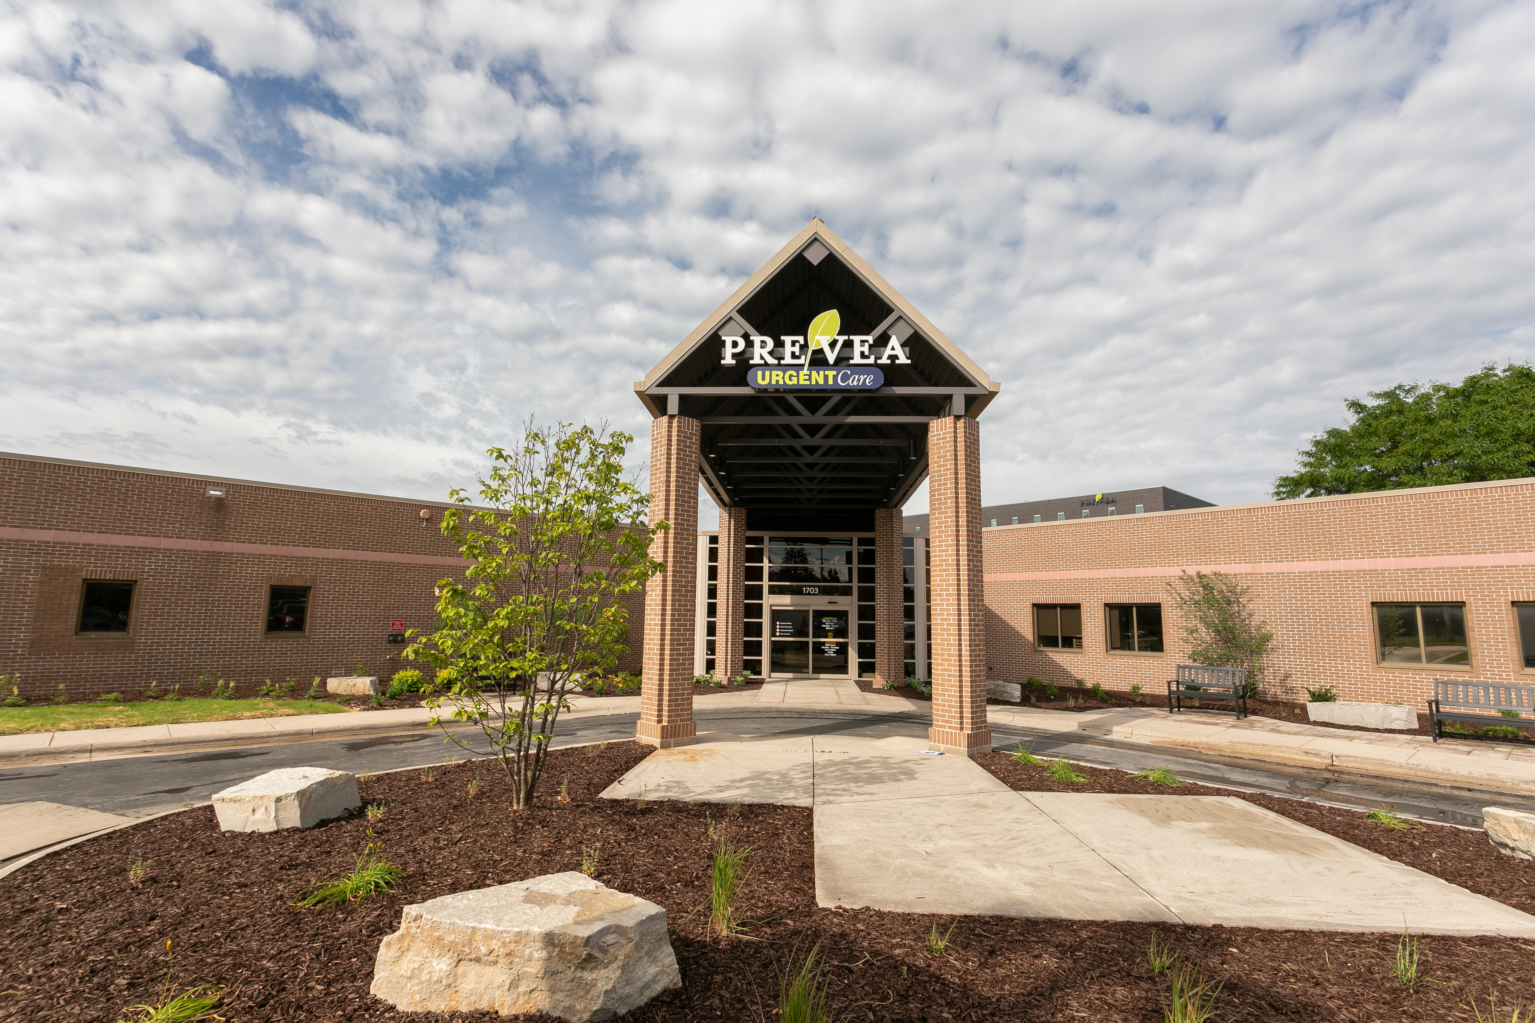
Facilities Updates
Name Change - Prevea Health – Green Bay (1860 Shawano Ave)
  Previously - St Mary’s Medical Office Building
Sheboygan Site Consolidation - Prevea Health - Sheboygan (1703 N. Taylor Dr.)
  Closed Sheboygan sites:
    Superior 2920
    Superior 3425
    Taylor 1411
57

Slide 58
EPIC Training updates
Same as HSHS update- Workday
Students will get an email with their Workday account info and training will be in their account. Email will NOT explicitly refer to EPIC training.
Trainings are virtual on demand
58

Slide 59
DAX Copilot
DAX Copilot (DAX) is a HIPAA secure AI tool that Prevea will integrate into patient appointments via the Epic Haiku app. DAX is currently only available for the ambulatory setting.
UPDATE - Rooming staff and Providers ask EVERYONE in the room for consent.
Talking points for rooming staff when sharing the consent aid with patients:
  [Physician/Provider name] is using DAX to help with their documentation.
  This allows for:
    More quality time and focus on you during the visit instead of note taking.
    Ensures all details of your conversation are captured, making sure nothing is missed.
    Dedicates more focus to discussing your needs, answering questions and building a stronger connection.
If there is any concerns or decline, DO NOT use DAX.
59

Slide 60
Student Work Positions
Clinical Support Aide (CSA 1 & 2)
  Designed so MA, LPN, EMT, can transition into new roles seamlessly, usually within the same department upon certification/licensing.
  RN students can utilize these roles they just won’t be guaranteed a position upon licensing.
  CSA 1 – individuals in first semester of program
  CSA 2 – individuals in clinicals or graduated without license/certification – can be used as an MA rotation!
Radiology Imaging Assistant
  Radiology students
  Flexible scheduling
  Assist in performing x-rays
Phlebotomy
  Prevea roles/onboarding
Youth Apprentices
60

Slide 61
College
Updates
Bellin College
NWTC
UW – Green Bay
61

Slide 62
Presenters
Bellin College
Dr. Mark Bake, Chief Academic Officer
NWTC
Brian Krogh, Dean, Health Sciences
UW Green Bay
Dr. Wendy Bauer, Director, Nursing & Health Studies
62

Slide 63


Bellin College Update
May Graduates
  Pre-licensure BSN
  Radiologic Sciences
  Diagnostic Medical Sonography
  Radiation Therapy
  Surgical Assisting
  Graduate Nursing
    MSN (NE, FNP, PMHNP)
    DNP (BSN-DNP FNP, MSN-DNP)
  DScPT
  DPT
October Graduates
  Anticipate BSN Graduates
63

Slide 64
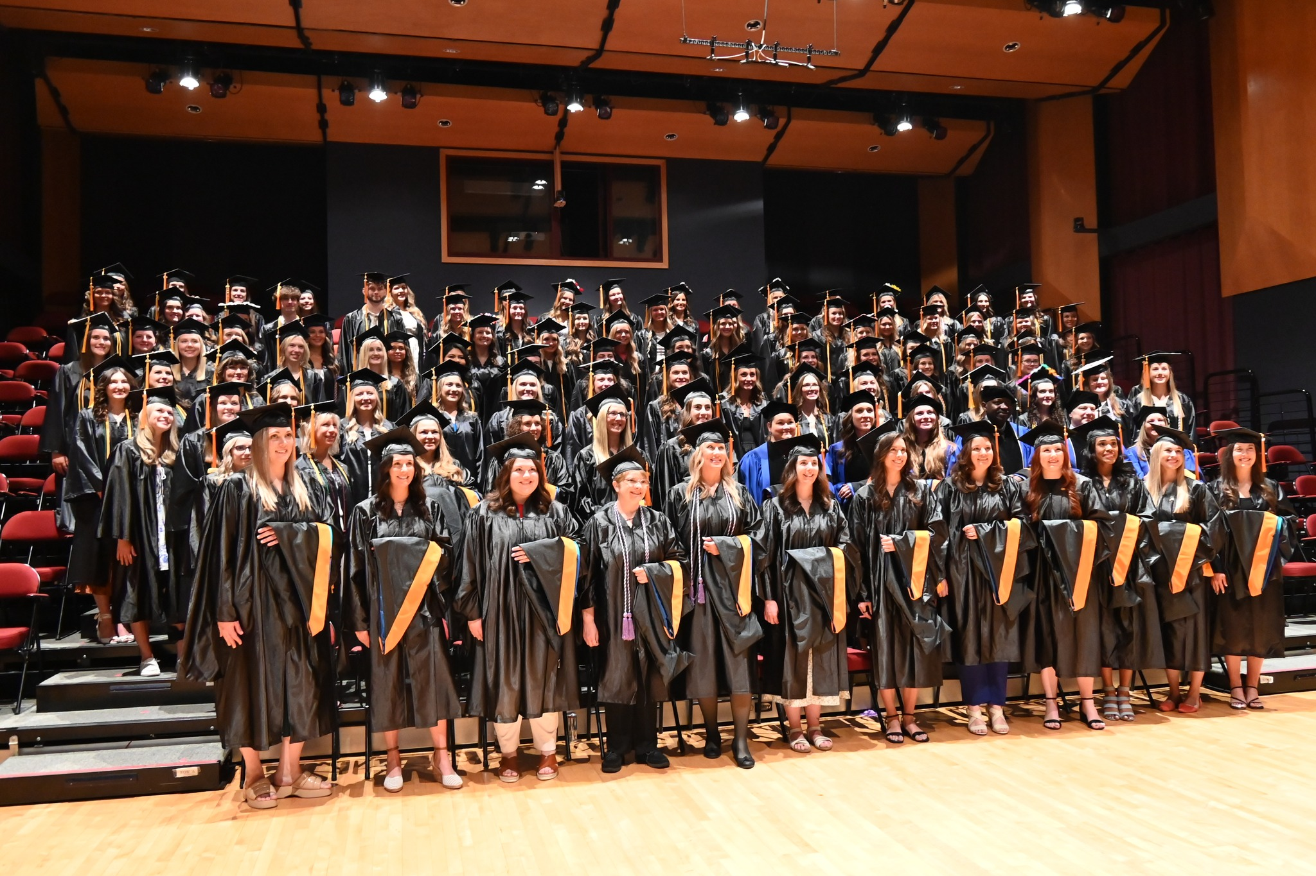
Bellin college update
Strong enrollment for fall 2026.
Graduate programs transitioning to 14-week trimesters.
Completed $15 million capital campaign.
Hired a new full time Student Support and Well-Being Coordinator.
64

Slide 65
Bellin College Nursing Programs
BSN Program
  2-year transfer
  3-year traditional
  15-month
Strong enrollment
Five new clinical faculty hired 2025-2026.
Heidi Monroe, NCLEX Success Coordinator, retiring in December 2026.
Continuing to expand our clinical/community partnerships
65

Slide 66
Bellin College Graduate Nursing Programs
Master’s Degree and Post-Graduate Certificate Program Tracks
FNP (hybrid)
PMHNP (online) - 1st cohort graduated May 2026.
NE (online)
Doctor of Nursing Practice
BSN-DNP
  FNP (Hybrid)
  PMHNP (online)
MSN-DNP (online)
MSN (NE) and DNP programs are approved for WI Nurse Educator Loan Program
66

Slide 67
Bellin College Allied Health Sciences
  Surgical Assisting | Surgical Technology
    Started transfer option for Surgical Assisting Program with prior ST experience
    Seeking Initial Accreditation for ST
  Radiologic Sciences
    Strong interest, 18 students enrolled for Fall 2026, new faculty hired
  Radiation Therapy
    Expanding clinical sites, Penn Medicine being a recent signed site
  Diagnostic Medical Sonography
    Continue to expand the online adult echo certificate nationally with over 15 students in Fall
67

Slide 68
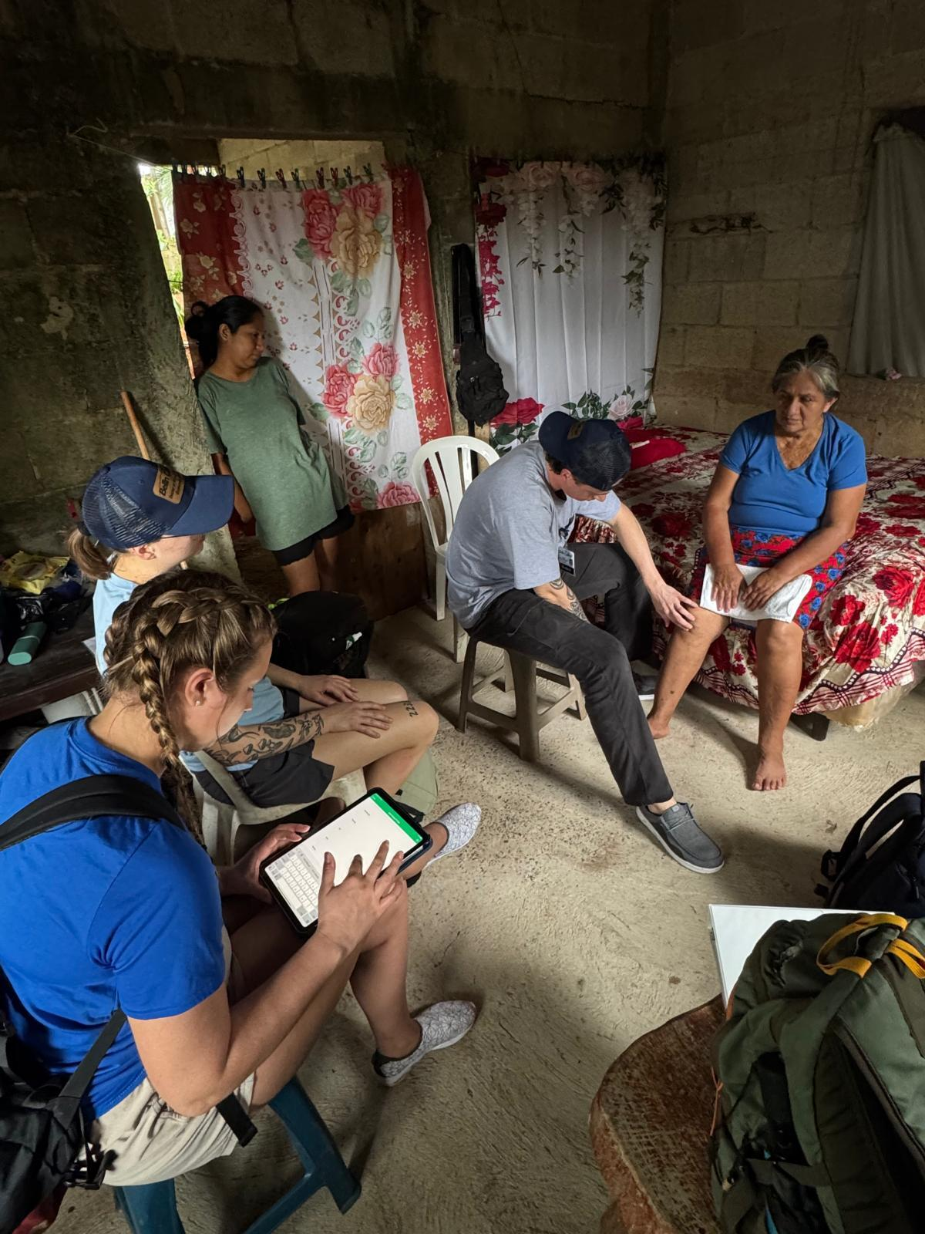
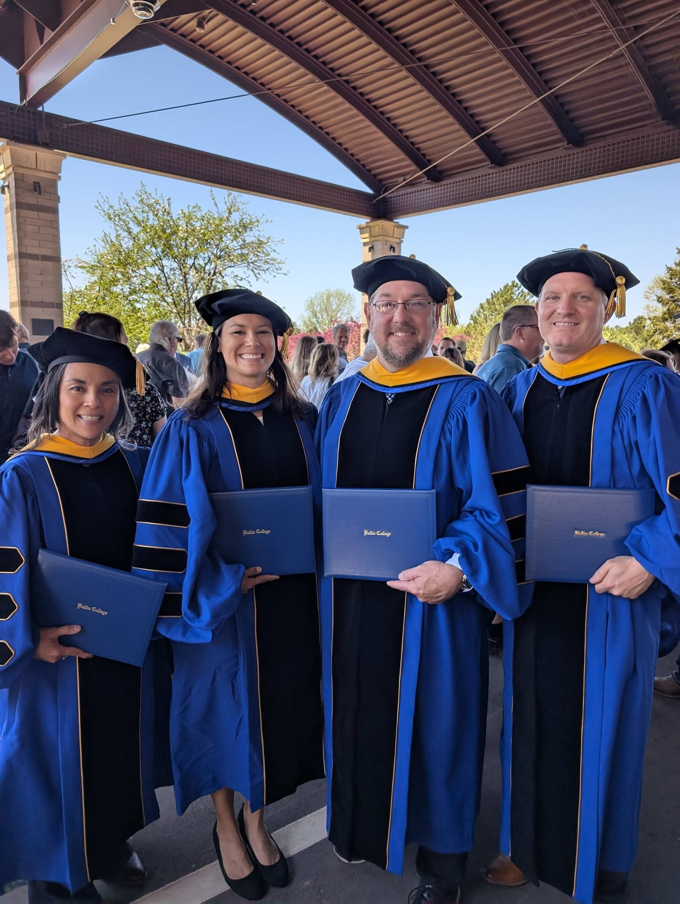
Bellin College Physical Therapy
Doctor of Physical Therapy (DPT)
100% Licensing Exam Pass rate for class of 2025
Inaugural DPT Mission trip to Guatemala, spring 2026
Orthopedic Manual Therapy Fellowship
Expanded to offer additional orthopaedic residency for new graduates
Doctor of Science
Expanding curriculum with emphasis on the science of teaching
55 Peer reviewed publications since 2021
68

Slide 69
Bellin College Contacts
Diana Amundson - Surgical Assisting Program Director
Dr. Mark Bake – Chief Academic Officer
Dr. Eric Chaconas – Associate Dean of Physical Therapy
Dr. Amanda Hogan – Associate Dean of Undergrad Allied Health
Amy Riemer – Radiation Therapy Program Director
Dr. Christina Smith – Radiology Program Director
Dr. Jon Weiss – DPT Assistant Program Director
Dr. Sherri Hanrahan – BSN Program Director
Dr. Lori Kulju – Associate Dean of Nursing/Graduate Nursing Program Director
Amanda Super – NA Program Coordinator
Danielle Van Camp– Academic Clinical Affiliation Coordinator
69

Slide 70


NWTC Update
70

Slide 71
NWTC Contacts
Brian Krogh– Dean, College of Allied Health & Nursing
Cindy Theys – Associate Dean, College of Nursing
Nursing Assistant, Medical Assistant, Practical Nursing, Associate Degree Nursing
Selena Zimmerman – Associate Dean, College of Allied Health
Dental Hygienist, Dental Assistant, Diagnostic Medical Sonography/Echocardiography, Physical Therapist Assistant, Radiography, Respiratory Therapist, Surgical Technologist, Therapeutic Massage, Wellness and Health Promotion, Health Information Technology/Medical Coding, Medical Laboratory Technician,
Laura Stephenson– Nursing Program Director
Associate Degree Nursing, Practical Nursing, Nursing Pathways
71

Slide 72
Updates
NCLEX
Enrollment
Grants
Expansion/Remodel
72

Slide 73

Greater Green Bay
Health Care Alliance
Annual Update
August 14, 2026
73

Slide 74
UWGB faculty & Staffing Updates
July 2026
Wendy Bauer, PhD, RN
Director, Nursing & Health Studies (NHSU)
August 2026
Laura Swoboda, DNP
Assistant Professor
Continued growth in clinical faculty and instructional support for the prelicensure program
74

Slide 75
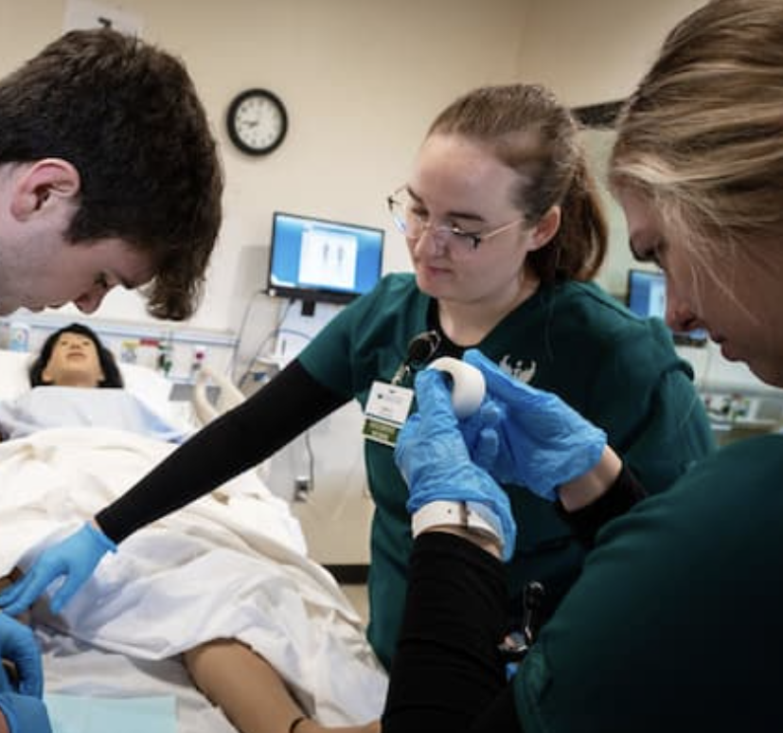
UWGB HEALTH & HEALTHCARE UNDERGRADUATE EDUCATION
Nursing
Prelicensure BSN
RN to BSN – BSN@Home, Universities of Wisconsin Collaborative
ADN to BSN – collaboration with Lakeshore College
Health & Community
Community Health Education (BS)
Social Work (BSW)
Psychology (BS)
Health Information Management & Technology (BS) – Universities of Wisconsin Collaborative
75

Slide 76
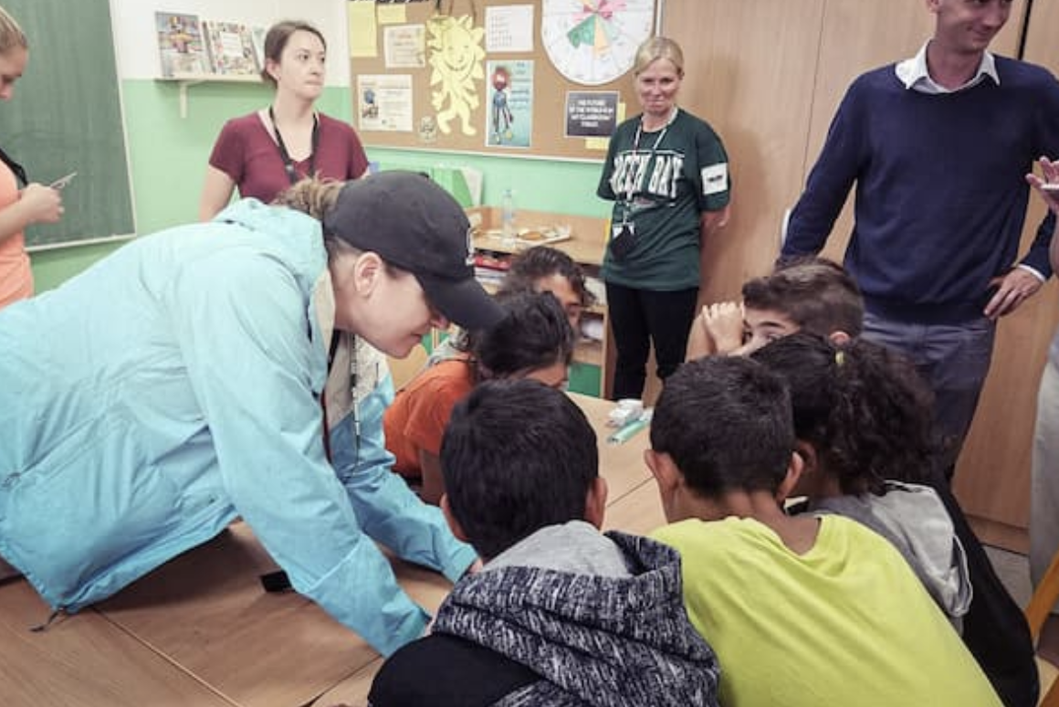
UWGB HEALTH & HEALTHCARE UNDERGRADUATE EDUCATION
Human Biology – BS
Health Science
Exercise Science
Applied Public Health
Nutrition & Dietetics
Cytotechnology
Sports Medicine
General Human Biology
76

Slide 77
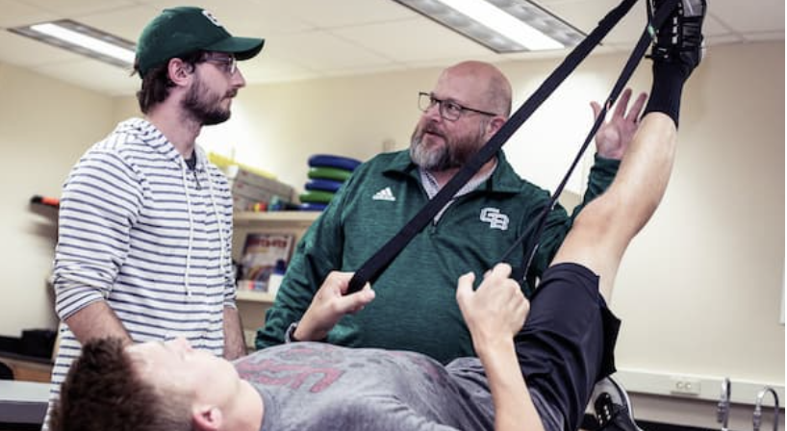
UWGB HEALTH & HEALTHCARE
GRADUATE EDUCATION
Nursing Leadership & Management (MSN)
Health & Wellness Management (MS)- Universities of Wisconsin Collaborative
Social Work (MSW)
Nutrition & Integrated Health (MS, RDN pathway)
Athletic Training (MAT)
Sport, Exercise, & Performance Psychology (MS)
77

Slide 78

NHSU developing priorities 2026-2027
Rural & Community Health
Expanding rural and community-based learning opportunities
Advancing interprofessional education in emergency response and community health education
Clinical Education
Strengthening partnerships with clinical agencies
Expanding underutilized clinical opportunities and interprofessional education
78

Slide 79
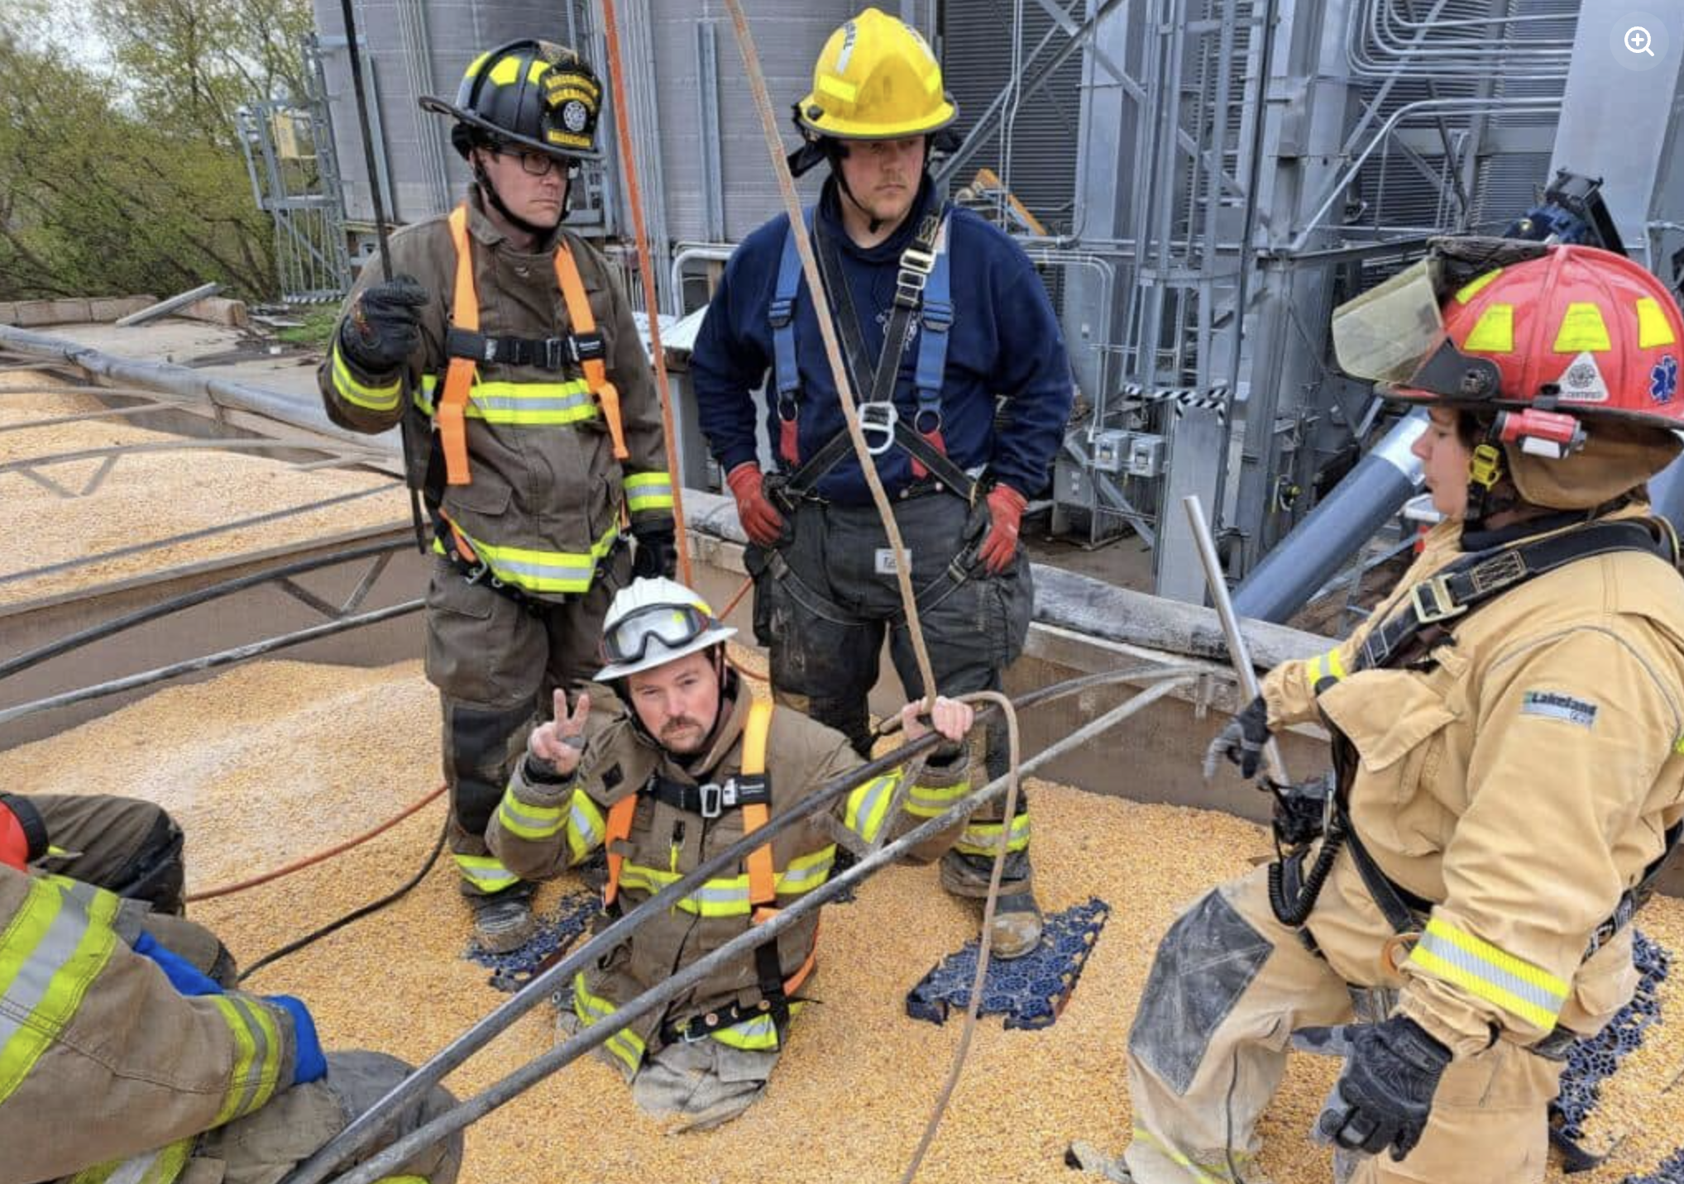
NHSU developing priorities 2026-2027
Simulation & Experiential Learning
Increasing integration of simulation
Supporting clinical judgment and practice readiness
Workforce Development
Aligning programs with regional healthcare workforce needs
Building pathways from education to professional practice
79

Slide 80
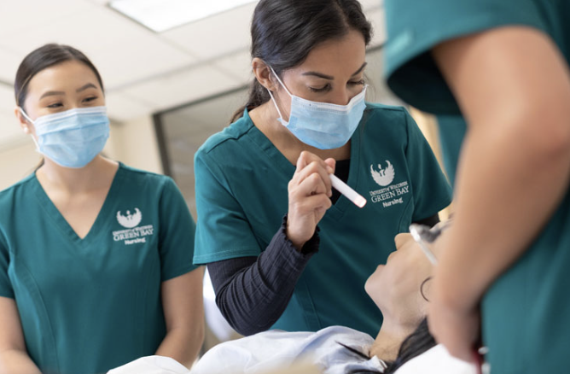
UWGB NURSING & HEALTH STUDIES UNIT
NHSU Contacts
Wendy Bauer, PhD, RN
Director, Nursing & Health Studies
bauerw@uwgb.edu
Kaitlin Williams
Practicum Assistant
williamk@uwgb.edu
THANK YOU!
80

Slide 81
Thank you for viewing the updates.
Hope you have a great academic year!
www.ggbha.org
81

