Slide 1
Greater Green Bay
Health Care Alliance
Clinical Instructors Annual Update
August 8, 2025

Slide 2
Welcome
Sherri Hanrahan
BSN Program Director | Bellin College &
Chair of the Greater Green Bay Health Care Alliance
August 2025
CIAU - August 2025 - ggbha.org
2

Slide 3


Greater Green Bay Health Care Alliance
GGBHA.ORG
CIAU - August 2025 - ggbha.org
3

Slide 4


Hospital & Clinic
Updates
Advocate Aurora Health
Bellin Health
HSHS Hospitals
Prevea Health Clinics
CIAU - August 2025 - ggbha.org
4

Slide 5
Presenters
Aurora Health Care
Laura Janssen, Professional Development Specialist
Bellin Health
Kelly Verhasselt, Professional Development Coordinator
HSHS Hospitals
Jenn Leonard, Manager, Clinical Education
Prevea Health Clinics
Sarah Schmidt, Talent Acquisition Specialist
CIAU - August 2025 - ggbha.org
5

Slide 6

Aurora BayCare medical center
Laura Janssen MSN, RN, NPD-BC
Nursing Professional Development Specialist
Laura.Janssen@aah.org
(920) 288-3427, Teams Message me for a quicker response
ASC-ClinicalAffiliations@aah.org for EPIC/Workday access questions or other questions
CIAU - August 2025 - ggbha.org
6

Slide 7
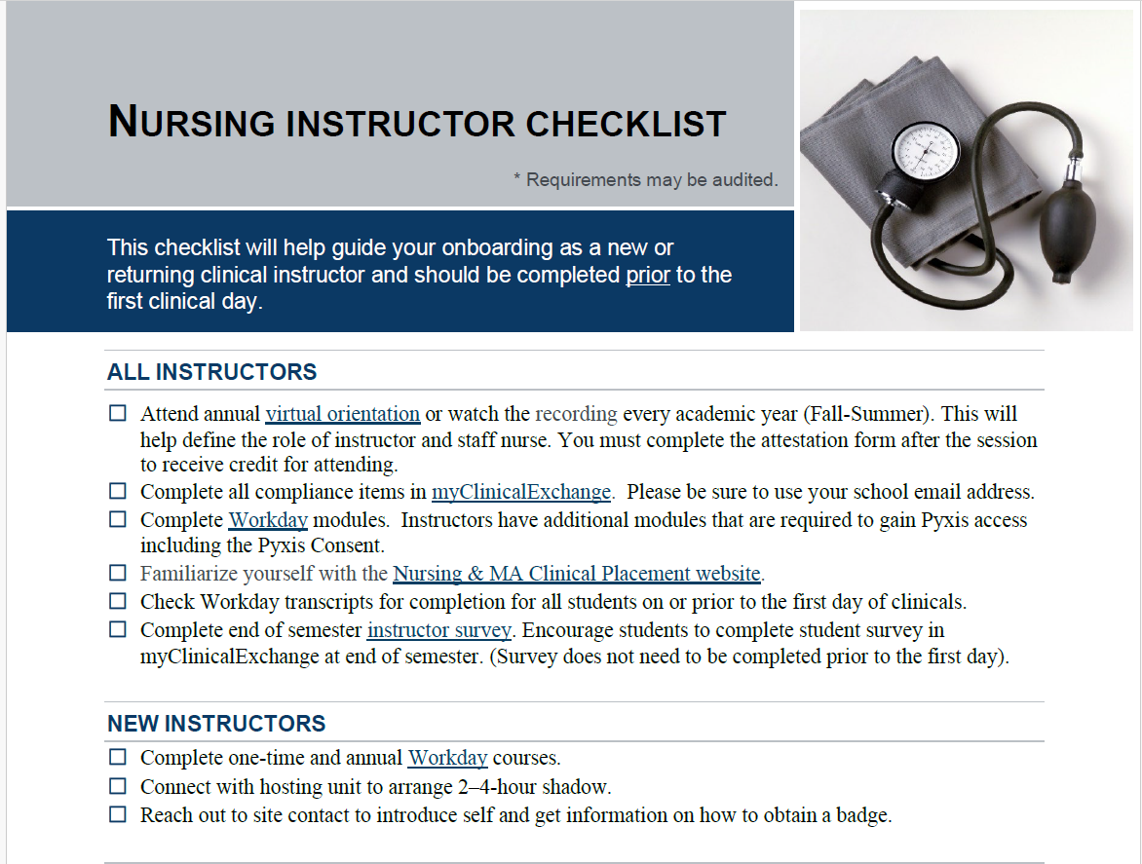
INSTRUCTOR ORIENTATION
All instructors must complete an Advocate Health orientation session once per academic year (fall-summer) and attest to their completion (live or virtual session)
Links to register are on the Advocate Aurora's Student's Website: Instructor Orientation
NEW Instructor checklist: Utilize for onboarding documents, process, important needs/deadlines
CIAU - August 2025 - ggbha.org
7

Slide 8
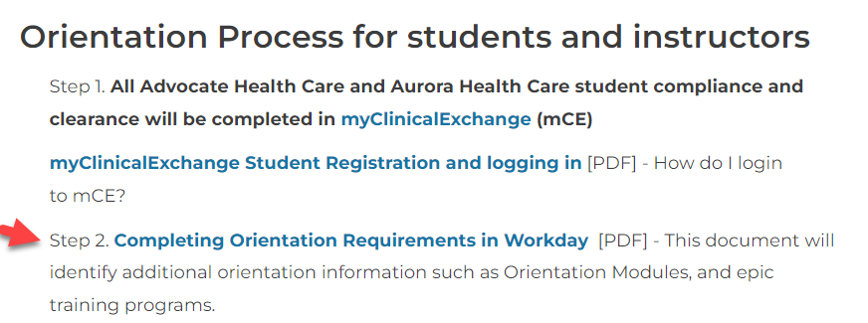
STUDENT WEBSITE
Please review the student website prior to the beginning of every semester.
Nursing & MA Student Clinical Placement | Aurora Health Care
Under Orientation for Students and Instructors section, there is a key document listing orientation requirements.
Annual Education released
August 4, 2025
CIAU - August 2025 - ggbha.org
8

Slide 9
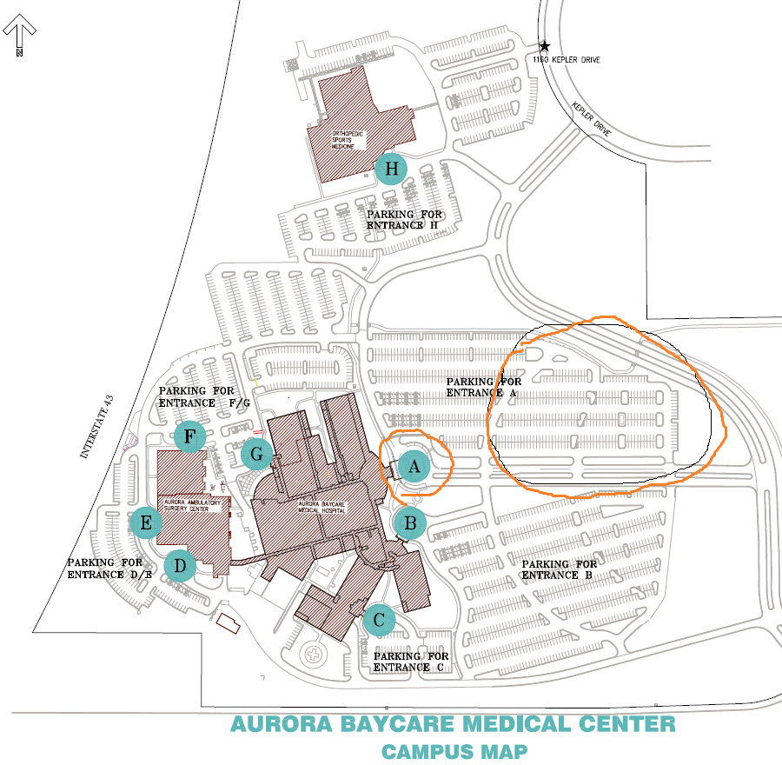
PARKING
Continue to park in the spots beyond the boulevard and enter in Entrance A.
Entrance B is for staff with badge access and remains locked 24/7. Under construction now, TBD opening date
CIAU - August 2025 - ggbha.org
9

Slide 10
Instructor Picture Badges
Aurora BayCare Medical Center (ABMC) will now create an ABMC badge for Instructors. The badge will give you access to hallway doors as well as the medication rooms. Please return any clam (white, blank badges) to security and pick up your ABMC badge.
You will need to submit a picture to security team, or you can take one on site. Please send pictures to Ross.Jasmer@aah.org and cc myself for any follow up
CIAU - August 2025 - ggbha.org

Slide 11
COVID Updates
COVID Vaccinations Advocate Health (AH) no longer requires a COVID vaccination for teammates, physicians, APCs, vendors, students, volunteers or contractors. Therefore, no exemptions are needed.
However, the vaccine is encouraged if you will be taking care of COVID+ patients.
Fit Testing
Students and instructors may care for airborne isolation patients if Fit Tested with an AH mask.
Annual Requirement – 1 year renewal date required in myClinicalExchange (mCE). If school/student chooses not to get Fit Tested, choose “N/A” in mCE.
First mask of choice – Mask - 3M 1870+
The instructor must be fit tested for the clinical group to care for COVID+ patients.
The school will provide Fit Testing or you may be tested at another facility. It is optional to be Fit Testing.
CIAU - August 2025 - ggbha.org
11

Slide 12
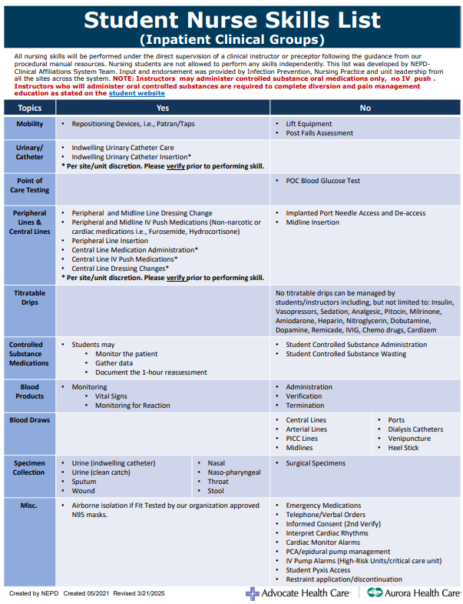
STUDENT NURSE POLICY UPDATES
Please continue to reference the student can and can’t do skills list located on all the units in the tube station room as well as the undergraduate student nurse policy
Aurora BayCare Medical Center skills list may be different than Marinette, Two Rivers, and Oshkosh
CIAU - August 2025 - ggbha.org
12

Slide 13
New Additions to skills list (ABMC specific)
Students and Instructors can insert foley catheters under the following conditions: an ABMC RN must be in the room and depending upon the patient care area, the Urinary Catheter Huddle form must be completed prior to insertion
Students and Instructors can NOT perform central line dressing changes
Students and Instructors can access and administer IV push medications through a central line, check for approved medications.
These skills may vary from Aurora sites – please refer to each site for variances

Slide 14

Instructors Passing Oral controlled substances
Reminder that if the instructor would like to remove and pass oral controlled substances – the following workday modules must be completed in Workday:
Reminder that the instructor can only remove the medication and GIVE the oral controlled substance. Please also notify the primary RN for the patient if scheduled or PRN oral controlled substances are being given. This is written in red print on the top of the skills can and can't do list.

Slide 15
MY CLINICAL EXCHANGE
Precepted rotations require an In-person or virtual meeting between the preceptor, student, and instructor.
The expectation is to have 1-2 additional touch points during the rotation
Students must complete a 1 to 1 preceptor off-site faculty meeting form found in mCE along with the other compliance documents prior to the first day of clinicals.
CIAU - August 2025 - ggbha.org
15

Slide 16
Cosigning Documentation
Remind students to select their preceptor or instructor as cosigner for EPIC documentation
All documentation must be cosigned by the end of the clinical day – ALL medications administered and any Flow sheet documentation
Pull in the "Cosign Report" from the Summary Activity
CIAU - August 2025 - ggbha.org
16

Slide 17
Practice reminders
Oral care TWICE daily
Sage CHG bath once daily for all patients with central lines and for patients with un-accessed ports
Peri care and catheter care once daily
Bed alarms, chair alarms, gait belt when needed
No Soap and Water in basins for bath instead use: Sage Bath Wipes, or can use washcloth with running water and soap can be used, new washcloth for each area
New Tube Feeding Pumps – Cardinal Omni
Updated Alaris pumps coming later in the fall, interoperability Q4
Call Rapid response for unwitnessed falls
Assign 1-2 students per week to administer medications
CIAU - August 2025 - ggbha.org
17

Slide 18
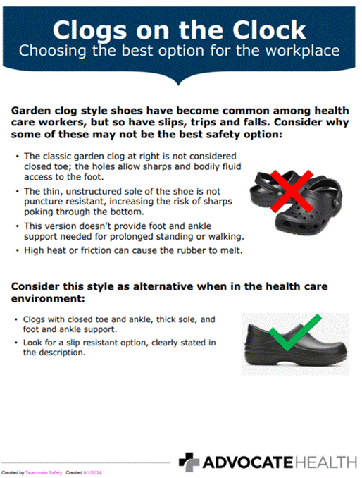
PRACTICE REMINDERS

Slide 19
Additional Modules (not required)
“Inpatient Bed Review” – great overview of the Stryker beds, bed alarms, bariatric bed, etc.
"Foundational TIDE (Trauma-Informed De-escalation Education") - Defines Workplace violence and strategies to de-escalate
CIAU - August 2025 - ggbha.org

Slide 20
Required immunizations
TB test and annual screening questionnaire
Rubella
Influenza (October-March)
Declination form on student's Website for others
Influenza Vaccine accommodation – through "TrackMy" reach out for form/instructions

Slide 21
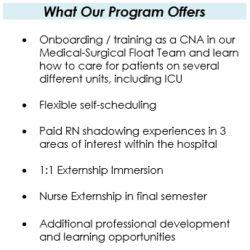
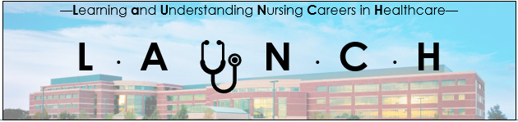
L.A.U.N.C.H. Program
Any nursing student that is CNA certified can reach out to Nichole.lauf@aah.org for more details.
CIAU - August 2025 - ggbha.org
21

Slide 22

Kelly Verhasselt, MSN, RN
Professional Development Coordinator
kelly.verhasselt@emplifyhealth.org
Carrie Karcz, MSN, RN, AMC-BC
Ambulatory Nurse Educator
carrie.karcz@emplifyhealth.org
CIAU - August 2025 - ggbha.org
22

Slide 23

Emplify/Bellin Health Updates
Continuing to expand student groups in mCE to include nursing assistants, medical assistants, NP’s
Establishing walk-in mental health services at BPC for pediatric clients-more information to come!
CIAU - August 2025 - ggbha.org
23
Notes:
The plan is for the walk-in clinic to open around the start of the school year; this is specific to pediatric children, more details will be available in the next month or so!

Slide 24
Emplify/Bellin Health Updates
Level III NICU October 2025- transitioning with Children’s of Wisconsin partner for neonatology professional services- full transition anticipated by 07.01.2026
Pulmonary and Sleep Clinic will be moving to 725 S. Webster Ave in Sept
Continue with remodel on 5th Floor at BMH- adding 2 Cath labs- complete by April 2026
CIAU - August 2025 - ggbha.org
24
Notes:
We currently are a Level II NICU, meaning we can take babies > 32 weeks and > 1500 grams. As a level III NICU, we will be able to take any gestation and weight. This brings a significant advancement in acuity and need for new advanced skills. Our team has been working hard to get ready to take critical babies through hands-on skills sessions, didactic learning, online modules and upcoming shadow shifts at Children’s.
Pulmonary and Sleep lab currently at the hospital on 7thn floor, but moving the 725 building in Sept

Slide 25
Emplify/Bellin System Updates
Virtual nursing programs went live in March 2024, and have already shown incredible results and received overwhelmingly positive feedback.
Tasks include: patient rounding, transfer of care, discharges, patient education, & admissions.
Looking at virtual patient sitters
Virtual Nursing is now live on 5 inpatient areas
(Ortho, Surgical, Medical, Cardiac, & Observation Unit)
CIAU - August 2025 - ggbha.org
25

Slide 26

Ambulatory Updates
Bellin Surgery and Specialty Center now houses the following outpatient specialties:
  Asthma and Allergy
  ENT
  Gastroenterology
  Neuropsychology
  Podiatry
  Rheumatology
  Prepare
  Orthopedic
CIAU - August 2025 - ggbha.org
26

Slide 27

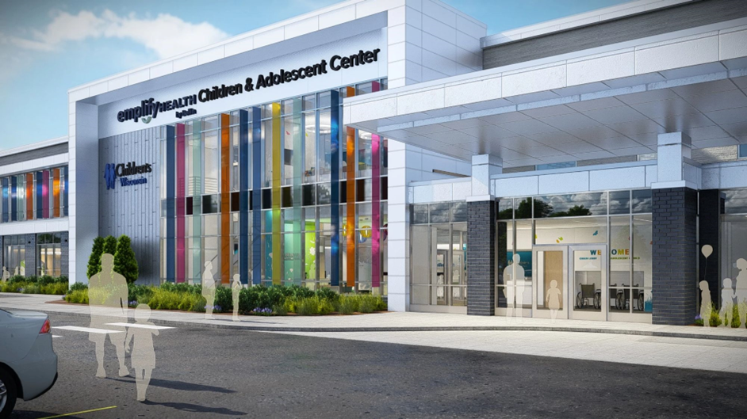
Ambulatory Updates
Emplify by Bellin Children & Adolescent Center
2550 S. Ashland Ave. Ashwaubenon, WI 54304
Open House: Aug 20th | 4:00 PM - 7:00 PM
Building will house:
  Emplify primary care and specialty providers
    ENT
    Behavioral Health
    Adolescent Care
    Pediatrics
  Children’s Hospital of Wisconsin specialists as part of the “Connected for Kids” partnership

Slide 28
Ambulatory Updates
Technology:
  Glooko remote patient monitoring for diabetic patients
    New technology to allow for closer monitoring of diabetic patients, now available in primary care, Generations (OB/GYN), maternal fetal medicine, and Endocrinology
  Project Fusion
    Emplify (Bellin + Gundersen) is moving to one platform for Epic
    Student Epic (OUTPATIENT CLINIC ONLY) cosigning will look a little different for students and preceptors in the outpatient clinic settings
    There will probably be a change in flowsheet cosigning. MAR cosigns should look the same
    Final build on this is not yet complete but we will communicate changes once it is completed
CIAU - August 2025 - ggbha.org
28

Slide 29

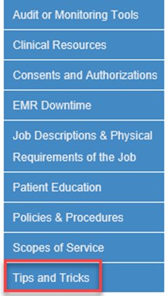
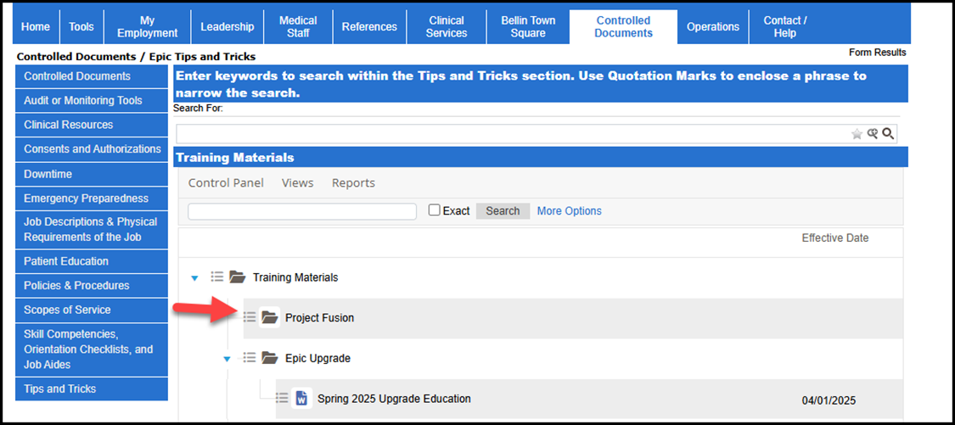
Epic/Project Fusion Updates
Finding Upgrade Documents on Julius Find and reference upgrade education any time by visiting the Controlled Documents page of Julius.
Open Julius.
Select the Controlled Documents tab.
Select Tips and Tricks on the left side
Project Fusion Learning Pathway
CIAU - August 2025 - ggbha.org
29
Notes:
Access Project Fusion micro-learnings including guides, tip sheets and short videos via the Learning Pathway site. Many trainings assigned in HealthStream can be found here as well.

Slide 30
Epic/Project Fusion Updates
New Terms
Clinician (MD, DO, PA, NP)
Non-Clinician (Nursing, Pharmacy, Chaplin, Nutrition)
Our Practice Advisory (OPA)- formerly BPA (best practice alert)
Social Services- formerly Case Management
Deterioration Index- formerly MEWS (modified early warning system)
Advanced Care Planning (ACP)- formerly Advanced Directives
Marcros- created and used to automate repetitive tasks to save time
CIAU - August 2025 - ggbha.org
30
Notes:
Macros- often used for flowsheets

Slide 31
Epic/Project Fusion Updates
    Patient Story Board- learn more about the patient, their goals, care plan, discharge plans
    BLN Complex Neuro Assessment and GHS Complex Neuro Assessment (can remove GHS)
    Patient Pass- site for patient education, formerly Elsevier
    Brain- provides an overview of your patients, events, tasks, medications, & other actions.
    Care Plan Documentation- there will now be an end of shift note- chart outcome: progressing, not progressing, adequate for discharge, completed
CIAU - August 2025 - ggbha.org
31
Notes:
Brain functionality is triggered by medications, if you document something as a “yes”—cascading questions may appear, tests or appointments (OT, PT) being added.
Students do not chart in the care plan, but it is good for them to be able to view the plan of care each shift and take note of how the patient is progressing, or possibly not progressing.

Slide 32
Co-signing Student Documentation
Faculty can run reports to verify all student charting has been reviewed and co-signed.
Select the appropriate reports and click run:
BLN IP LPN/SNT/GN Missing “My” Cosign for Flowsheets and BLN BPC LPN/SNT/GN
Missing My Cosign for Flowsheets will look for any of your patients in the department you are currently logged into needing flowsheets cosigned.
CIAU - August 2025 - ggbha.org
32
Notes:
Reminder for faculty to review and cosign student charting.
By picking the one with “my” in it they will get the ones assigned to them. If they pick the other one they will get all the patients for the floor in the last 30 days.

Slide 33
Infection Prevention: COVID-19 & Influenza
Covid-19 vaccination Recommended to stay “Up to Date” as defined by CDC. Submit Proof of Vaccination, Declination form, or medical exemption. Self-screen for COVID Symptoms: Fever or Chills Cough, Sore Throat, Congestion, or Runny Nose Shortness of Breath, Difficulty Breathing Fatigue or Muscle/Body Aches Nausea or Vomiting, Diarrhea New Loss of Taste or Smell | INFLUENZA (FLU) VACCINATION Recommended Annually (or approved Exemption). Submit Proof of vaccination, declination form or medical exemption Self-screen for Flu Symptoms: Fever or Feeling Feverish/Chills Cough, Sore Throat, Runny or Stuffy Nose Fatigue or Muscle/Body Aches Headaches
CIAU - August 2025 - ggbha.org
33
Notes:
In the case of increased local, regional, or state spread of respiratory illnesses, masking and/or other source control measures needed to prevent the spread of illness may be required regardless of vaccination status, and at the discretion of the Infection Prevention Team.

Slide 34
Equipment Updates / Changes / Reminders
Use of Arjo Sit-to Stand
New safety equipment for those meeting non-violent criteria: (see Restraint/Seclusion Policy)
  HeadStart Chair Alarm Belt Resources: https://tidiproducts.getbynder.com/web/4effedbaad0e0d64/headstart-chair/
  HeadStart Bed Alarm Belt Resources: https://tidiproducts.getbynder.com/web/4a54b10e1638f3cc/headstart-bed/
  Posey Secure Sleeves Resources: https://tidiproducts.getbynder.com/web/47ad75f853e3d559/secure-sleeves/
  Peak-A-Boo Mitts Resources: https://tidiproducts.getbynder.com/web/73baaf88b7890e40/2811---peak-a-boo-mitt/
CIAU - August 2025 - ggbha.org
34
Notes:
Some areas will see the new Arjo sit to stand and are designed to assist patients in standing up from a seated position, promoting mobility and reducing the risk of falls.

Slide 35
Policy Updates / Changes / Reminders
Bedside Mobility Assessment Tool (BMAT 2.0)
  Done on admission, daily, transfer, after a fall, or change in condition.
  Daily assessment should occur prior to mobilization
ABCS Fall Injury Risk Assessment
  Identifies those at risk for injury.
  Completed on admission and any change in condition (better or worse)
  24 Hour Post Fall Assessment- after a fall has been documented, the 24-hour post fall assessment rows will populate (this will create a task in the brain as a reminder)
CIAU - August 2025 - ggbha.org
35

Slide 36
Policy Updates / Changes / Reminders
Blood Administration Policy updates coming- changes related to the dual sign-off process
Nova StatStrip Changes with project Fusion
No longer using glucose gel-being replaced with glucose tablets
CIAU - August 2025 - ggbha.org
36
Notes:
With the Project Fusion, the data management system that was formerly used to configure the glucose meters (NovaNet) is changing to a version that matches what our Gundersen partner uses. This will result in a few changes in how the meter will present to the operators. Workflow should remain the same.

Slide 37

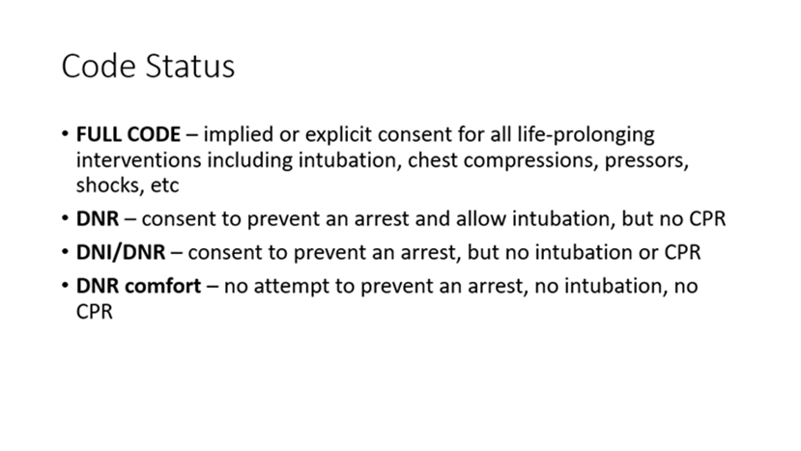
Inpatient Code Status
Inpatient Code Status DNR/DNI order changes

Slide 38
Regulatory & Compliance
Covid tracking forms are still required
Student/Faculty Badge’s
Will be working with IT security on process for student/faculty access to our policies- more to come!
CIAU - August 2025 - ggbha.org
38
Notes:
Continue with same badge process. Some colleges have already reached out for the spread sheet. Bellin College students are using there bellin College badge.

Slide 39
Nurse Intern Opportunities
The nurse intern (formerly Student Nurse Tech) program is intended to provide nursing students with the opportunity to develop skills that will benefit them in their professional growth and development. Working as a nurse intern can provide students with a great foundation for nursing.
ADN: Eligible at the start of your final semester
BSN: 3 year: eligible at the start of final semester
  4 year: eligible when starting senior year
    15 month: eligible during the final 7 months of your program
    visit careers page: www.bellin.org/careers
CIAU - August 2025 - ggbha.org
39

Slide 40
Bellin Staffing Changes / Updates
CEO
  Dr. Scott Rathgaber
Educators
  Kari Holl ICU
  Ann Hansen Titletown Orthopedics
Team Leaders
  Jolene Hendricks Surgery
  Jessie Schaumberg ICU
CIAU - August 2025 - ggbha.org
40

Slide 41

HSHS Hospitals
St. Vincent, St. Mary’s, St. Nicholas, St. Clare
Jenn Leonard, MSN, RN
Manager-Clinical Education
CIAU - August 2025 - ggbha.org
41

Slide 42
Executive Leadership Changes
St. Mary’s
Chief Administrative Officer-Leah Bergstrom
St. Vincent
Chief Nursing Officer-Isabelle Garabaldi
St. Nicholas
Chief Administrative Officer-Andrew Bowman
St. Clare
Chief Administrative Officer-Colleen Koski
CIAU - August 2025 - ggbha.org
42

Slide 43
Leadership Changes
St. Mary’s
St. Vincent
Emergency Department-Mel Jacobson
St. Nicholas
Director Patient Care Services-Courtney Loebel
Med Surg/ICU Manager-Matt Thayer
St. Clare
CIAU - August 2025 - ggbha.org
43

Slide 44
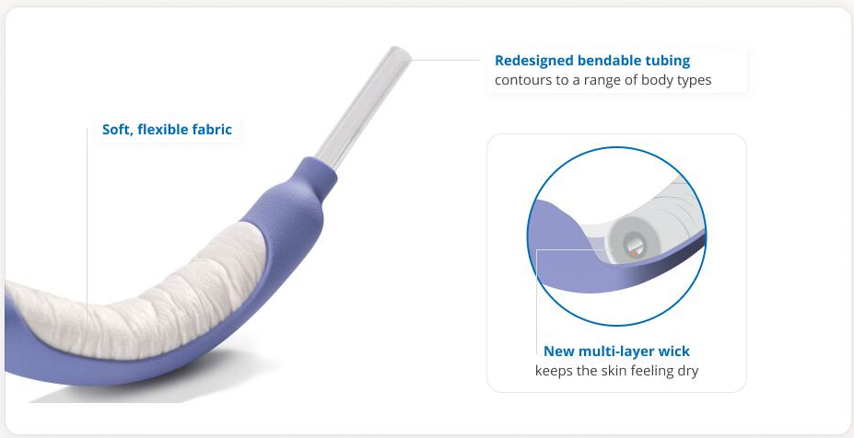
Products
PureWick Flex
Coming soon with go live for foley free ICU
Central line dressing kit (changes coming, timeline TBD)
Wireless chair and toilet alarms
CIAU - August 2025 - ggbha.org
44
Notes:
Foley Free ICU meant to remove foleys used for HOUDINI criteria of strict I&O
No clinical groups on ICU, but for precepted students, good for awareness
Wireless chair and toilet alarms-check with unit leaders or charge RN for information about how to use. Disposal requires lithium batteries to be taken off of toilets or chair pads

Slide 45
Initiatives
Epic Alaris pump interoperability
Integration of pump with Epic (two-way communication between Epic and Alaris)
Info about training to come (instructors invited to attend)
Heparin calculator
Transition to anti-Xa for majority of patients
Weight-based dosing (Alaris pump to be programmed as such)
CIAU - August 2025 - ggbha.org
45
Notes:
Training to begin mid-September and run through week of Thanksgiving. Go live date of 12/2.
If interested in training, email jenn.leonard@hshs.org

Slide 46
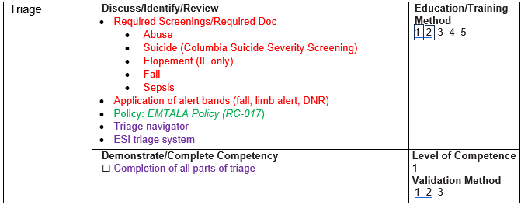
Tiered Skills Orientation
Tiered program that new nurses move through while observing their preceptor perform higher level skills.
Level 1: Assessment & Documentation
Level 2: Medication, Communication, Teamwork
Level 3: Safety & Quality
Level 4: Continuum of Care
Level 5: Workload Management
Now including: MedSurg, ICU, ED, Peds/PICU, NICU, OB, OR
CIAU - August 2025 - ggbha.org
46
Notes:
Not new topic but expanded areas for this year

Slide 47
Donna Wright Competency Model
Encourage subject matter expert (SME) at bedside to validate competencies
Opportunities for alternative ways of demonstrating competence (point of care validation, simulation, written exemplar)
Assigned quarterly as replacement for in-person skills days
CIAU - August 2025 - ggbha.org
47

Slide 48
Epic instructor training change
Applies only to new clinical instructors
Epic training moving into Workday
  Following submission of Epic access request form, new instructors will be added to Workday
  Email to instructors with instruction for access
  Assignment for test out will be made (also have option to complete training)
  Upon completion-instructor will receive email with test results
    Correct answers (to any questions answered incorrectly)
    Student guide with information about playground access
    Co-signing resource

Slide 49

Student Opportunities
HSHS Scholars program
  Scholarship funding (up to $10,000) for commitment to work at HSHS following nurse licensure
Summer nurse intern program
  Four-week experience for students who have completed at least 1 MedSurg clinical
  Shadowing experience (2 weeks MedSurg, 2 weeks specialty)
  Practice assessments, see day to day life of an RN
  Goal to retain interns into Nurse Extern 1 positions

Slide 50
Policies and Initiatives
Restraint policy updates
Mitts now considered restraints (even if not tied down)
Chemical restraints always considered violent
Suicide policy updates
Assessment now SAFE-T (no longer CSSRS long version)
Provider assessment more structured
CIAU - August 2025 - ggbha.org
50
Notes:
Training consists of online learning module, classroom portion (3.5 hours), practice packet completion (optional), and test.
Empowers RNs to know what’s going on with their patients (cardiac wise) when they get a call from Telemetry Technician.
Remote monitoring continues as previously, but eliminates RN not knowing what a rhythm change means.

Slide 51
Reminders
Parking
Updates for SMG to come as construction begins
Co-signing of Documentation
Please continue to ensure cosigning completed prior to leaving clinical day
CIAU - August 2025 - ggbha.org
51
Notes:
No changes

Slide 52

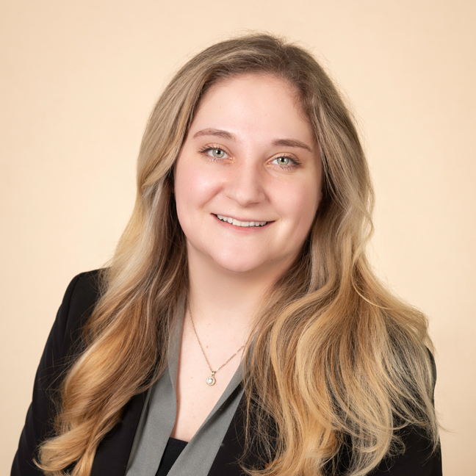

Prevea Health Clinics
Sarah Schmidt
Talent Acquisition Specialist
Sarah.Schmidt@prevea.com
920-429-1779
Nicole Mroczynski
Clinical Educator
52

Slide 53

Types of Rotations
Medical Residents
Medical Students
PA and NP
Therapy, including PT(A)/OT(A)
Medical Assistant
LPN
Surgical Technician – at ASC
Medical Laboratory
Healthcare Business
BSN Transitions
Radiography
Mammography
Ultrasound OB/GYN
Ophthalmology
Neurotechnology
53

Slide 54
Requests / Onboarding
For NP, PA, non-MCW Medical Student, Social Work, Dietetics, and Therapy rotations, use www.myclinicalexchange.com to submit rotation requests and complete compliance items.
  Change in process – Affiliation Verification Form
  Only fee for this is the mCE fee ($39.50/annually) isn’t associated with Prevea
All other programs use the traditional GGBHA process.
  Phone number required for Epic Access
54

Slide 55
EPIC Training updates
Same as HSHS update- Workday
Students will get an email with their Workday account info and training will be in their account. Email will NOT explicitly refer to EPIC training.

Slide 56
DAX Copilot
DAX Copilot (DAX) is a HIPAA secure AI tool that Prevea will integrate into patient appointments via the Epic Haiku app. DAX is currently only available for the ambulatory setting.
Talking points for rooming staff when sharing the consent aid with patients:
[Physician/Provider name] is using DAX to help with their documentation.
This allows for:
  More quality time and focus on you during the visit instead of note taking.
  Ensures all details of your conversation are captured, making sure nothing is missed.
  Dedicates more focus to discussing your needs, answering questions and building a stronger connection.
If there is any concerns or decline, DO NOT use DAX.

Slide 57
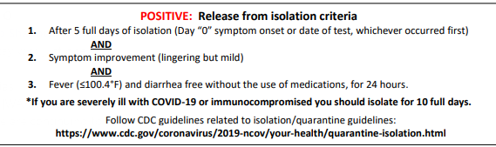
COVID Updates
Do not require proof of vaccination for COVID-19.
Students are required to follow CDC guidelines for testing and isolation.
Even though the CDC reduced the isolation days, we do not consider that for healthcare workers and the isolation time is still going to sit at 5 days additionally wearing a mask for 5 days after the isolation time.
57

Slide 58

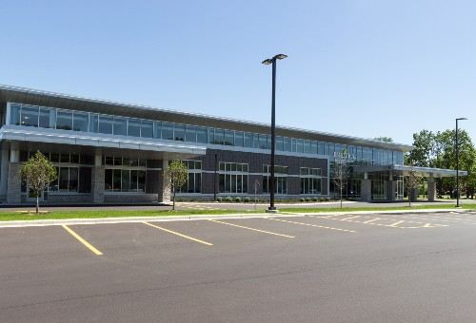
Prevea Health Unique Opportunities For Students
Rural Clinics
Ambulatory Surgical Center
Family Medicine Residency

Slide 59
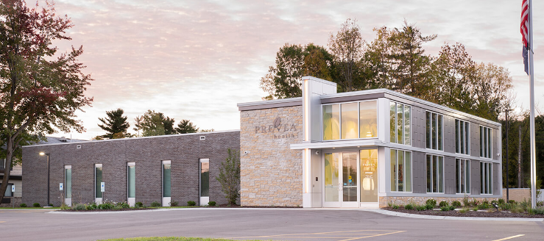
Unique Opportunities: Rural Clinics
Prevea Rural Medicine Clinics
  Mountain
  Suring
  Lena
  Gillett
  Oconto
  Oconto Falls
  Marinette
  Shawano
Rural Experience Benefits
Patients frequently come back, allowing you to develop long-term relationships with them.
Diverse experience including the SDoH challenges in rural communities
Rural nurses ( LPN, CMA, EMT) may have more autonomy in their roles such as working independently due to smaller clinic volumes
Rural nurses can see more procedures in clinic - due to lack of specialty providers in the area

Slide 60
Unique Experiences: Ambulatory Surgical Center
MULTIPLE specialties visit per week (next slide)
RN specialty clinical with Pre/Post/PACU/GI and Intra op rotation. This would give nurses an opportunity to see what the perioperative and peri anesthesia nursing offers.
Exposure to wide range of surgical procedures, enhancing hands-on skills in specialized environment.
Develop high adaptability by working in a dynamic environment that offers
  varied case types,
  patient needs,
  and working with multiple providers.
60
Notes:
ASCs work to provide the best surgical experience possible at a lower cost to patients. Because ASC’s can be more efficient when it comes to same-day surgery, patients typically pay less co-insurance at an ASC for the same procedure received in a hospital setting.

Slide 61
Ambulatory Surgical Center
Departments can include:
Ear, nose and throat
Gastroenterology
Ophthalmology
Orthopedics
Plastic surgery
Podiatry
Urology
Common procedures and surgeries include:
ACL repair
Cataract removal
Colonoscopy
Tonsil and adenoid removal
Ear tubes
And more!
61

Slide 62
Unique Experiences: Family Medicine Residency
Benefits for rotations in residency clinic-specifically at this site:
See Refugee patients. It is beneficial to see how communication is between staff and patients.
Different experience/interactions with resident physicians
Variety of minor procedures onsite that nursing staff assist with, such as lesion removals, wart treatments, joint injections and Nexplanon and IUD insertion and removals.
Observe addiction medicine treatment and a variety of other services.

Slide 63
Radiology imaging assistant (student)
Assists radiology technologists in performing imaging procedures.
8 hours per week, very flexible.
Students currently enrolled in a rad tech or general x-ray program.

Slide 64
Clinical Support Aide
Exciting opportunity for students to get a head start!
Designed so MA, LPN, EMT, can transition into new roles seamlessly, usually within the same department upon certification/licensing.
RN students can utilize these roles they just won’t be guaranteed a position upon licensing.
64
Notes:
The CSA is designed to support operations of the clinic.
It is designed for students and those enrolled in post-secondary healthcare programs. The bases of it is that IT does not matter if the person applying has a degree, working towards a degree, or not even officially signed up for a program in healthcare you can apply to this position. I leverage it to those who are in MA, LPN EMT, and nursing students because it allows them to put into practice what they are learning in the programs you offer and get paid to do so. All without having a license or certification.
After these students have received their license or certificate they can seamlessly transition from CSA to MA or LPN
RNs do have the option to be a CSA but they aren’t guaranteed a position upon licensing like MA’s or LPN’s
So a student just entering a program who is a CSA will then have this benefit to use towards your programs after 6 months. Or if they aren’t officially in your program yet, they can apply for this position wait 6 months for this benefit come into the program with field learning knowledge.

Slide 65
Clinical Support Aide 1& 2
CSA 1
  Enrolled in or currently taking first semester courses that teach the basics (vitals, patient positioning, etc.)
  Scope level is “basic”
    vitals
    rooming
    EKGs
    Point of care testing (i.e. blood glucose, urine drip)
    etc.
CSA 2
  Completed first semester and have done a skills check off to confirm “basics”. In the more advanced courses. OR
  Completed school and waiting on licensure/certification
  Scope level everything CSA 1 can do as well as (after skills check)
    Setting up/assisting provider with exams
    Disinfection/sterilization of instruments
    Venous phlebotomy
    Suture/Staple removal
    Etc.

Slide 66
Clinical Support Aide as MA Rotation
Utilize the Clinical Support Aide position for MA clinical rotations. Get paid and earn credit for rotations.
Students would go through the Prevea employee onboarding process. The school would not need to follow the typical health requirement process.
Task check off will be completed by supervisor to confirm functions/responsibilities
66
Notes:
We are aware that legislation has changed to allow MA students to use prior experience towards their clinical rotations. The CSA position we offer is prepared to extend this opportunity to your students.
This may be a benefit or not depending on how you view it, students who utilize the CSA as their clinical rotation would only have to go through the prevea employee onboarding process. The school would not need to follow typical health requirement process.
Then here is a list of tasks CSA’s can do after a skills check off…..
If you want more information regarding how this can work for your MA students or just information on the CSA role in general, please reach out to me and I’ll answer accordingly.

Slide 67
Other Exciting Opportunities!
Youth Apprentice experiences - Green Bay & Sheboygan
  Medical Assisting YA
  Nurse Aide YA
  Ophthalmic Tech YA
  Physical Therapy Aide YA
  Patient Service Rep YA

Slide 68
College
Updates
Bellin College
NWTC
Rasmussen University
UW – Green Bay
CIAU - August 2025 - ggbha.org
68

Slide 69
Presenters
Bellin College
Dr. Mark Bake, Chief Academic Officer
NWTC
Brian Krogh, Dean, Health Sciences
Rasmussen University
Erik Costea, Associate Dean of Nursing
UW – Green Bay
Dr. Christine Vandenhouten, Director of Nursing
CIAU - August 2025 - ggbha.org
69

Slide 70


Bellin College Update
May Graduates
  Pre-licensure BSN
  Radiologic Sciences
  Diagnostic Medical Sonography
  Radiation Therapy
  Surgical Assisting
  Graduate Nursing (FNP, NE, DNP)
  DScPT
  DPT
    First Cohort
October Graduates
  Anticipate BSN Graduates
CIAU - August 2025 - ggbha.org
70

Slide 71

Bellin college update
Increased enrollment for fall 2025
Recent announcement of the public phase of capital campaign.
Golf outing proceeds to highlight community partners and help fund programming
Hired a new full time Health and Wellness Coordinator.
CIAU - August 2025 - ggbha.org
71

Slide 72
Bellin College Nursing Programs
First 3-year curriculum cohort graduated in May 2025
  Last class of 4-year students graduated May 2025
Both traditional and 15-month curriculum has been revised
Continuing to expand our community partnerships
CIAU - August 2025 - ggbha.org
72

Slide 73
Bellin College Graduate Nursing Programs
Master’s Degree and Post-Graduate Certificate Program Tracks
FNP (hybrid)
PMHNP (online)
NE (online)
Doctor of Nursing Practice
BSN-DNP
  FNP (Hybrid)
  PMHNP (online)
MSN-DNP (online)
MSN and DNP programs are approved for WI Nurse Educator Loan Program
CIAU - August 2025 - ggbha.org
73

Slide 74
Bellin College Allied Health Sciences
  Surgical Assisting
    Growing clinical sites (Children's, Mayo, and more!)
  Radiologic Sciences
    Exploring sites for fluoroscopy and surgery
  Radiation Therapy
    Grads ranked in the top 10 percent nationally on the board exam
  Diagnostic Medical Sonography
    Expanding the online adult echo certificate nationally
CIAU - August 2025 - ggbha.org
74

Slide 75
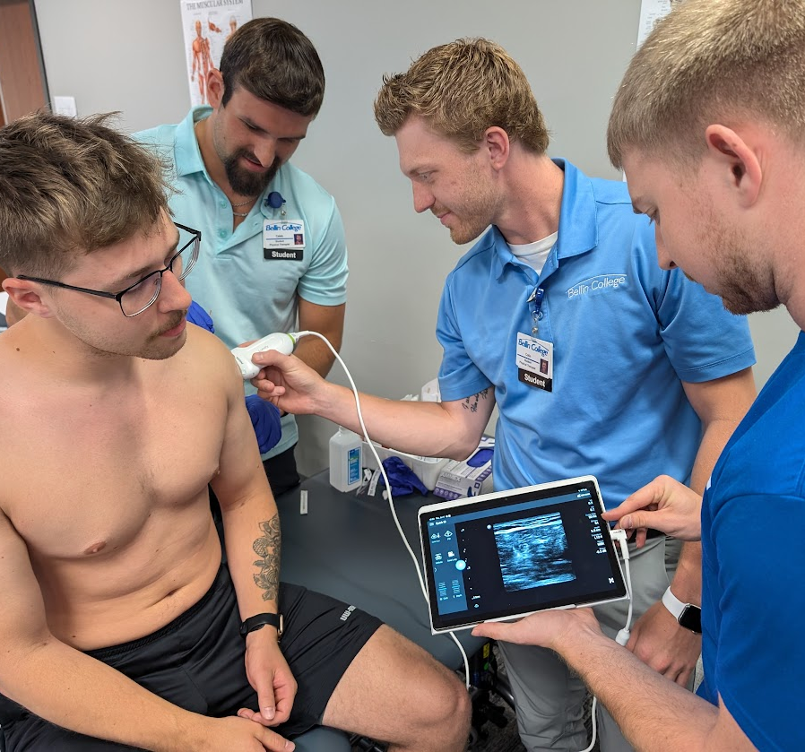
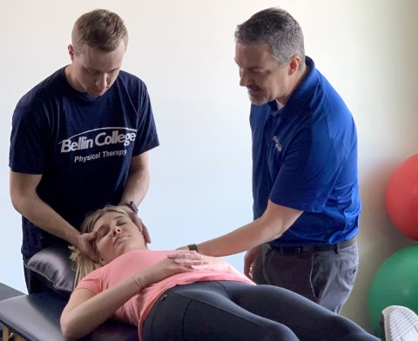
Bellin College Physical Therapy
Doctor of Physical Therapy (DPT)
Received full accreditation status with Commission on Accreditation in
  Physical Therapy Education
Cutting edge curriculum – Integrated Clinical Learning
Orthopedic Manual Therapy Fellowship
Post-DPT/Residence
National Program with mentorship across the country
Doctor of Science
Post-Fellowship program, leading PT research program
Designed for future academicians
CIAU - August 2025 - ggbha.org
75

Slide 76
Bellin College Contacts
Diana Amundson - Surgical Assisting Program Director
Dr. Mark Bake – Chief Academic Officer
Dr. Eric Chaconas – Associate Dean of Physical Therapy
Erin Demerath – Academic Clinical Affiliation Coordinator
Dr. Amanda Hogan – Associate Dean of Undergrad Allied Health
Amy Riemer – Radiation Therapy Program Director
Christina Smith – Radiology Program Director
Jon Weiss – DPT Assistant Program Director
Sherri Hanrahan – BSN Program Director
Dr. Lori Kulju – Associate Dean of Nursing
Amanda Super – NA Program Coordinator
CIAU - August 2025 - ggbha.org
76

Slide 77


NWTC Update
CIAU - August 2025 - ggbha.org
77

Slide 78
NWTC Contacts
Brian Krogh– Dean, College of Allied Health & Nursing
Cindy Theys – Associate Dean, College of Nursing
Nursing Assistant, Medical Assistant, Practical Nursing, Associate Degree Nursing
Selena Zimmerman – Associate Dean, College of Allied Health
Dental Hygienist, Dental Assistant, Diagnostic Medical Sonography/Echocardiography, Physical Therapist Assistant, Radiography, Respiratory Therapist, Surgical Technologist, Therapeutic Massage, Wellness and Health Promotion, Pharmacy Technician (Shared LTC), Health Information Technology/Medical Coding, Medical Laboratory Technician,
Laura Stephenson– Nursing Program Director
Associate Degree Nursing, Practical Nursing, Nursing Pathways
CIAU - August 2025 - ggbha.org
78

Slide 79
Educating Aspiring Registered Nurses
The new Nursing Workforce Diversity Program competition has been canceled (EARN)
We did get an extension for the existing grant to complete students through December 25
CIAU - August 2025 - ggbha.org
79

Slide 80

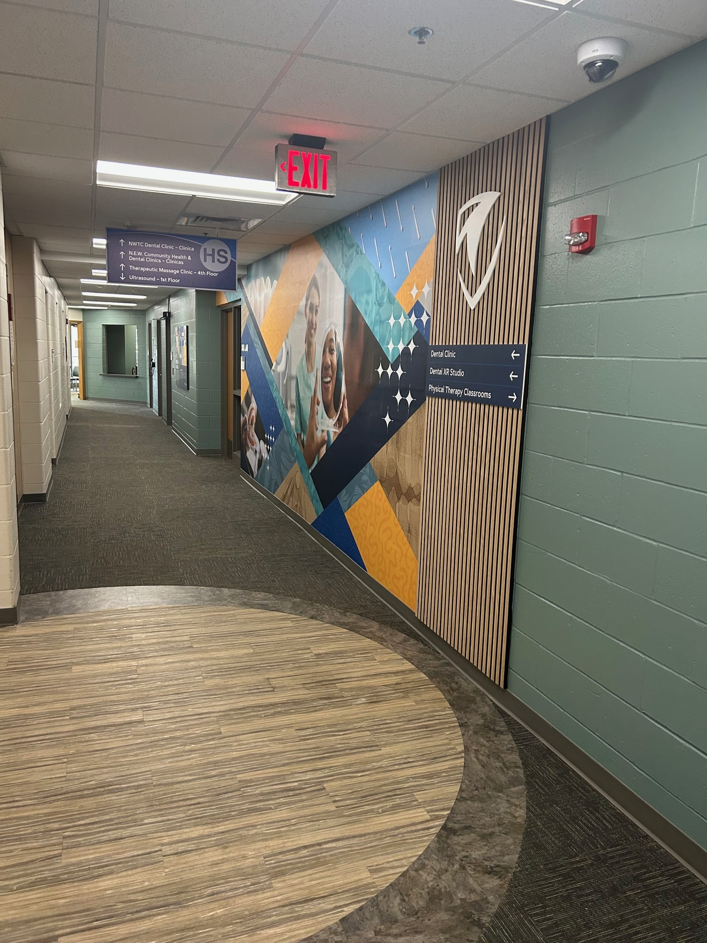
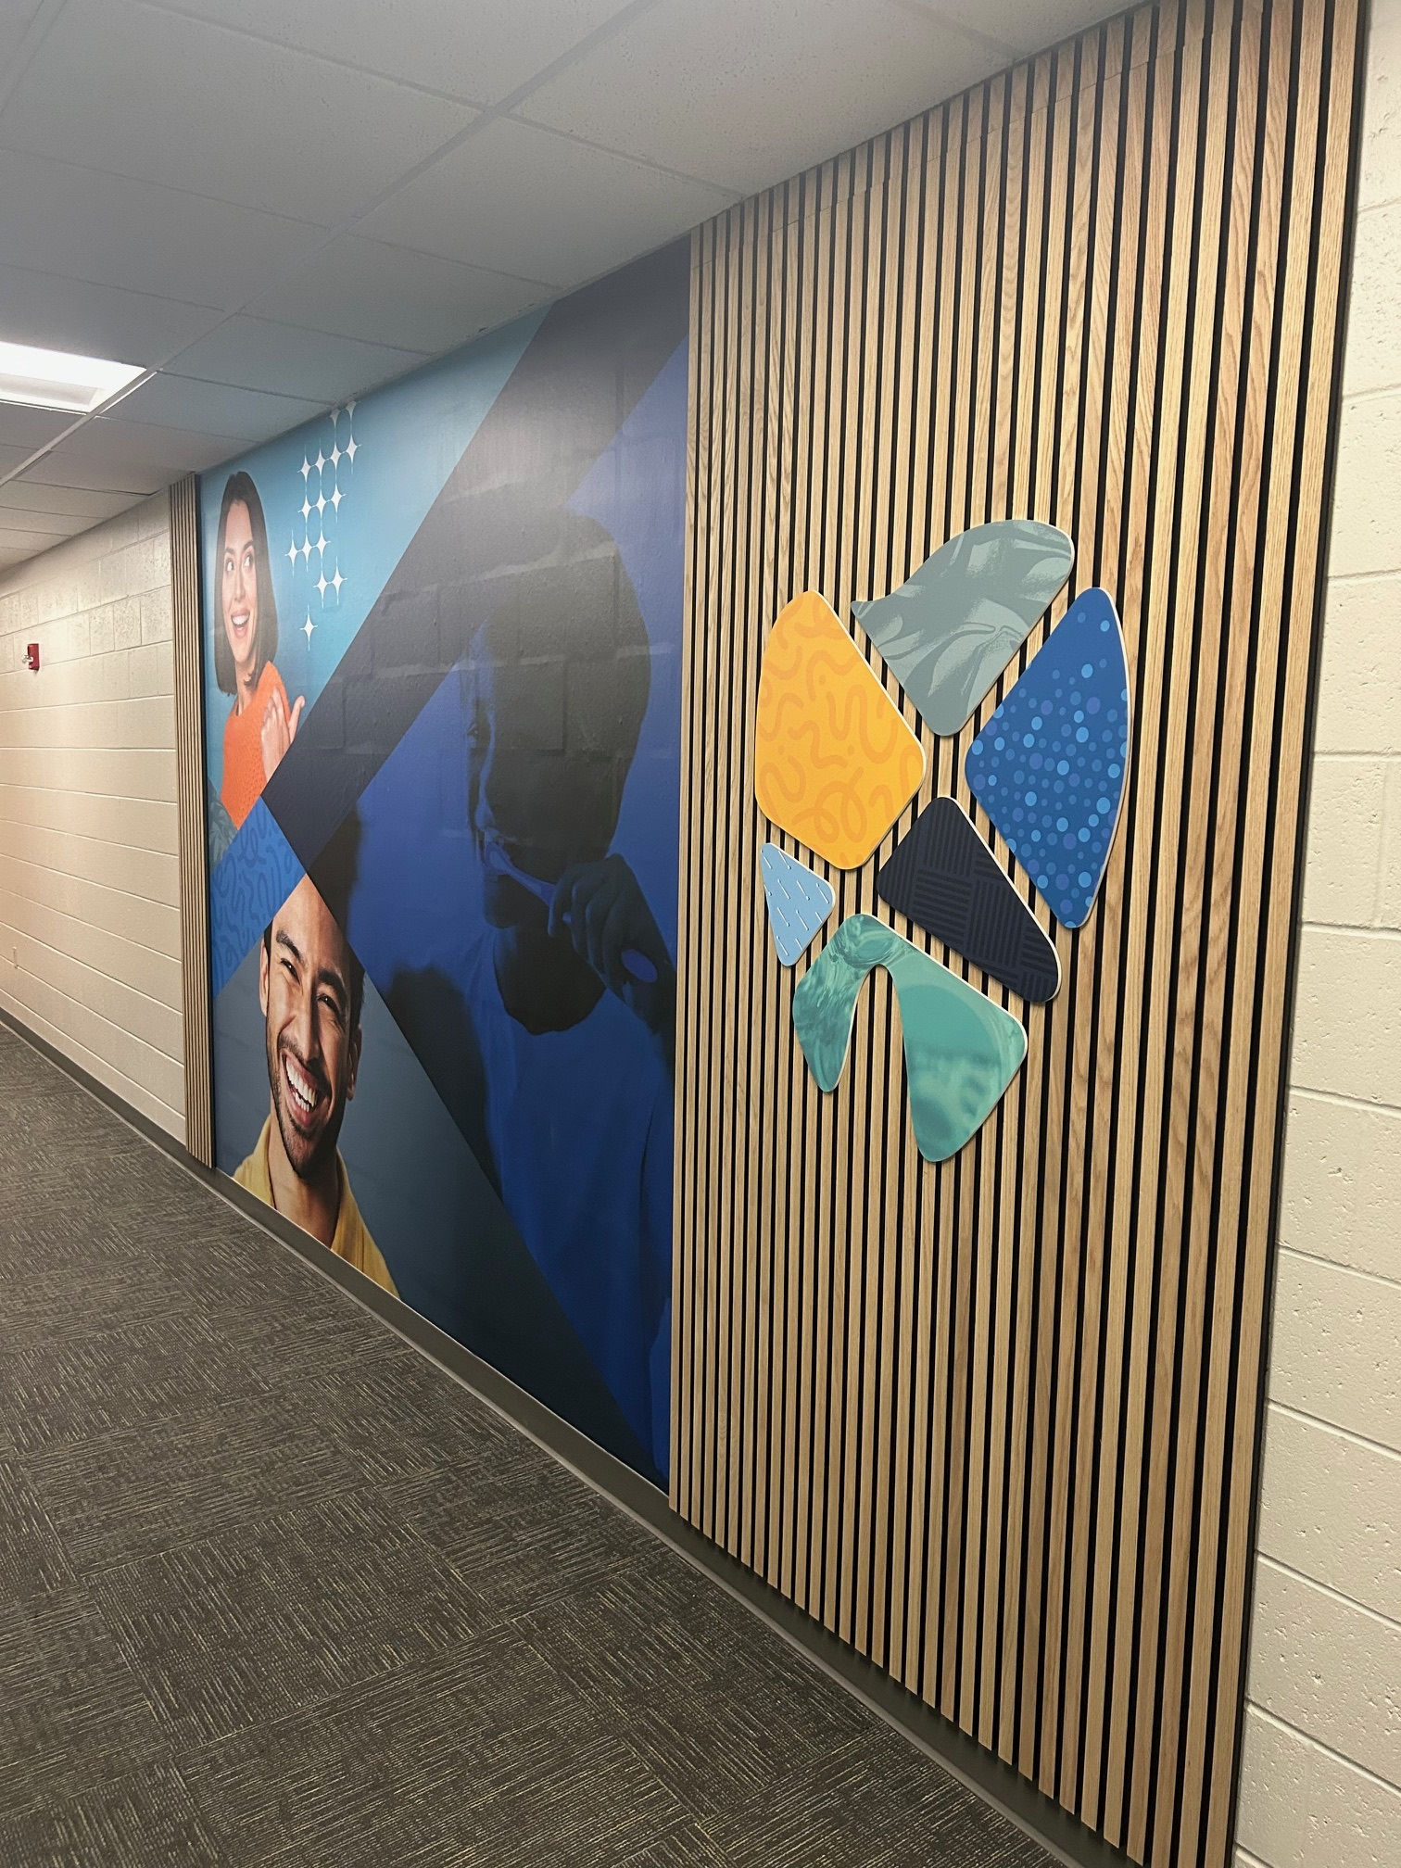
Dental Hygiene Remodel

Slide 81
Program Updates
Surgical Technologist – Associate Degree (Oct first graduating cohort of AD)
Nursing Assistant – Increased numbers summer and fall
Nursing Associate Degree
Dental Hygiene – Increased Cohort (30 students)
Expanded Function Dental Auxiliary (EFDA) Technical Certificate – First cohort

Slide 82

Rasmussen University – Nursing Program Offerings
Nursing (Campus-Based Programs):
Associate Degree in Nursing
Bachelor of Science in Nursing
  Standard Entrance Option
  Second Degree Option
CIAU - August 2025 - ggbha.org
82

Slide 83

Rasmussen University – Nursing program offerings
Nursing (Online-based Programs)
Bachelor of Science in Nursing
  RN to BSN
Master of Science in Nursing
  Nursing Leadership and Administration
  Nursing Education
  Healthcare Technology, Simulation and Informatics
  Adult-Gerontology Primary Care Nurse Practitioner (AGPCNP)
  Family Nurse Practitioner (FNP)
  Pediatric Primary Care Nurse Practitioner (PPCNP)
  Psychiatric-Mental Health Nurse Practitioner (PMHNP)
Doctorate of Nursing Practice
  Executive Leadership
  Public Health and Policy
CIAU - August 2025 - ggbha.org
83

Slide 84
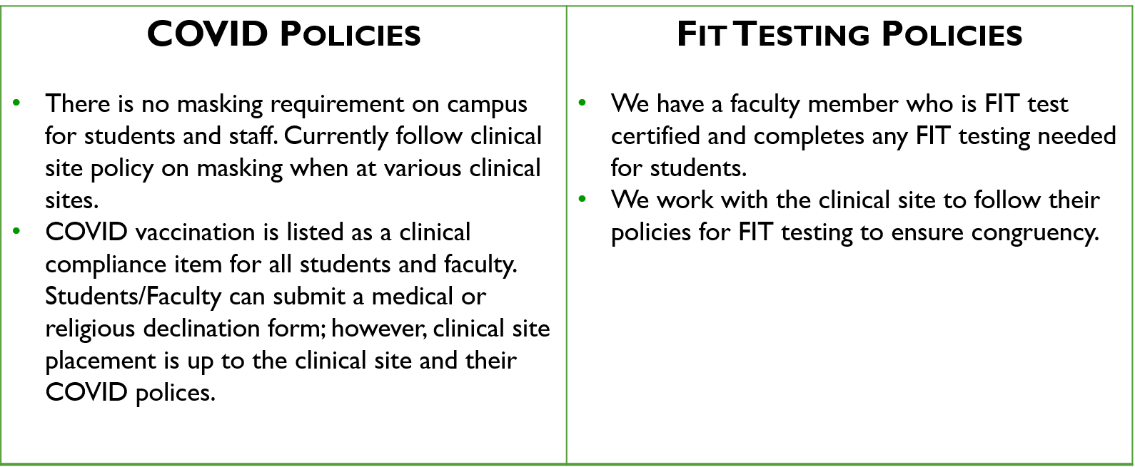
COVID & Fit Testing Policies
CIAU - August 2025 - ggbha.org
84

Slide 85

Rasmussen University Nursing Updates - Fall 2024
Current Number of ADN Students: 27
Current Number of BSN Students: 19
Expected Fall – September 2024 Graduates
  ADN – 4
  BSN – 2
Expected Winter – December 2024 Graduates
  ADN – 5
  BSN – 1
CIAU - August 2025 - ggbha.org
85

Slide 86

University Contacts
Kristin Wahl– Campus Executive Director
Erik Costea – Associate Dean of Nursing
CIAU - August 2025 - ggbha.org
86

Slide 87

TO OUR CLINICAL PARTNERS!
CIAU - August 2025 - ggbha.org
87

Slide 88
August 2025
UW-Green Bay
Updates for the Greater Green Bay Healthcare Alliance
Dr. Christine Vandenhouten, PhD, RN
Director of Nursing
88

Slide 89
UWGB Faculty Updates
New Faculty
Kelley McGuire PhD, RN Fall 2024
Amy Gatton MSN Faculty Fall 2025
New Nursing Advisor- Jenny Woelfel
CIAU - August 2025 - ggbha.org
89

Slide 90
Undergraduate Programs
Nursing
  Prelicensure
  BSN@Home
    Nurse 1-2-1 collaboration with NWTC
Health Studies
  HIMT
  Community Health Education
  Management in Health Systems Certificate/Emphasis

Slide 91
Undergraduate Programs Updates
Nursing
  BSN@Home- UW Superior joining the collaborative
  Forward- New RN-BSN Partnership with Lakeshore College
Health Studies
  Health Information Management and Technology (HIMT)
    Curriculum mapping to CAHIIM accreditation standards
    Virtual Accreditation visit March 2026
CIAU - August 2025 - ggbha.org
91

Slide 92
Graduate Programs
MSN Leadership & Management
MS Health & Wellness Management
CIAU - August 2025 - ggbha.org
92

Slide 93
UWGB Contacts
Christine Vandenhouten PhD, RN, CPH Director of Nursing; Chair Nursing & Health Studies
  Prelicensure BSN
  RN-BSN including Nurse 1-2-1
  HIMT Academic Director
  Community Health Education
  Health Management Certificate
Susan Hopkinson PhD, RN
  MSN Program Chair
Myunghee Jun PhD, RN
  MSHWM Academic Director
Misty Neal MBA
  HIMT Program Director
Nicole Micolichek & Jenny Woelfel
  Nursing Advisors
Kaitlin Williams
  Practicum Assistant
CIAU - August 2025 - ggbha.org
93

Slide 94

Thanks to our Clinical Partners!
Without you, we couldn’t exist!
CIAU - August 2025 - ggbha.org
94

Slide 95
Thank you for viewing the updates.
Hope you have a great academic year!
www.ggbha.org
CIAU - August 2025 - ggbha.org
95

